Slide 1
Using PATSTAT with SQL for beginners
A step-by-step guide with exercises
All examples executable in PATSTAT Online
V 2.9
May 2025
Notes:
For these slides, it is important also to read the notes which have been placed here.

Slide 2
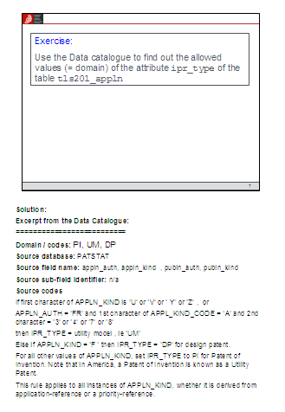
Purpose of this document
This document should enable you to understand how to write your own SQL (T-SQL) queries in PATSTAT Online.
Important: Please be sure always to view and study the Notes pane for each slide, where you will find essential additional information and the solutions to the exercises.
Notes pane
Notes:
For most slides, additional explanations or the solutions to exercises will be given in this space.
You can of course apply all the SQL know-how you acquire when studying this document to other SQL databases too. However, in this document we will cover only topics which are immediately relevant to PATSTAT. For example, you will not learn here how to design and create your own database. For such topics, please consult the internet or the bookshop of your choice.

Slide 3
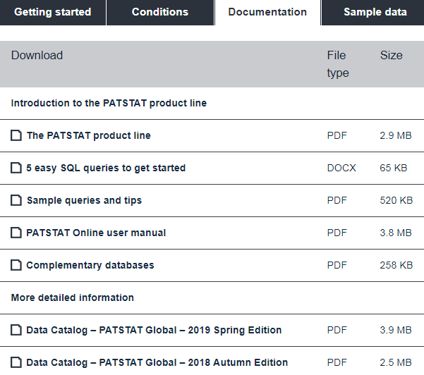
Additional resources
You will find more information on PATSTAT data, the PATSTAT Online search application, etc. for download under the Documentation tab on the EPO’s PATSTAT pages at epo.org//patstat

Slide 4
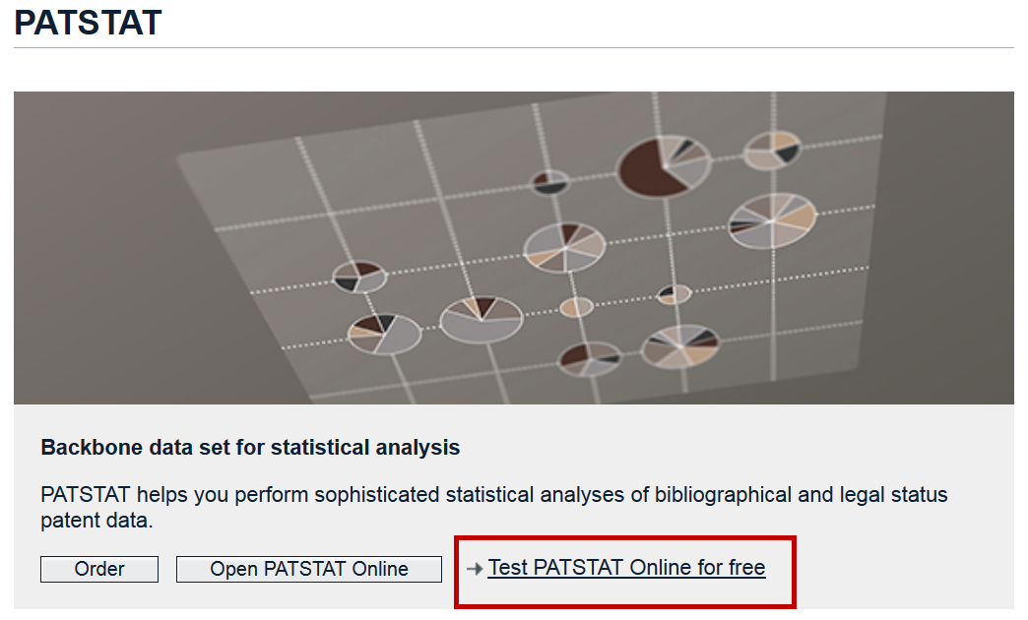
Prerequisites
To effectively follow the information in this paper and complete the proposed exercises, you will need access to a PATSTAT database.
You can ask for a free trial of PATSTAT Online on the EPO website at epo.org/searching-for-patents/business/patstat.html
It will also help if you
are familiar with the patent system in general (priorities, classification, families)
have experience in performing Boolean searches (AND, OR, NOT)

Slide 5
Content
Basics of relational databases
Your first query
Querying a single table
Querying multiple tables
Grouping, counting and aggregating rows
Subqueries
More useful SQL features
Frequently used JOINs
Tips when writing queries
Wrap up

Slide 6
Basics of relational databases

Slide 7
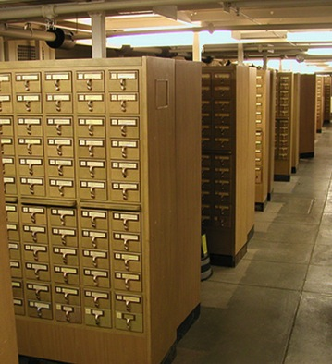
Data storage
Pre-computer-age
data storage
Today: Relational databases
Ideal for structured data
It's all in tables
SQL (T-SQL) query language
Notes:
SQL (Structured Query Language) is the industry standard for the retrieval and manipulation of relational databases and it is ubiquitous in the IT world. To query PATSTAT, you only need to know the query functionality of SQL; more specifically T-SQL (Transact-SQL).
Note: The concept and syntax of SQL differs significantly from bibliographic or Boolean query languages typically used by patent searchers.
Note that MS Access is not capable of managing the complete PATSTAT database, because it can only handle databases up to 2 GB. It can, however, be used to hold a subset of the data downloaded from PATSTAT Online.

Slide 8
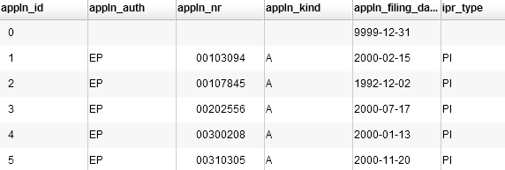
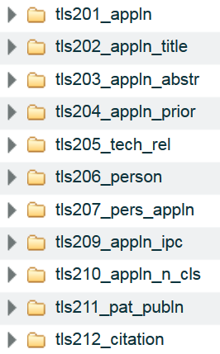
Tables, Rows, Columns
A table consists of columns and rows (also called record). A cell contains 1(!) data item of a certain type, which can be a string, a number or a date.
A relational database is a collection of linked tables.
Notes:
The list of tables can be found on the left-hand side of the PATSTAT Online search window.
Each list entry can be expanded to show the attributes of a table (attributes = columns of the table).
To see the content, e. g. the first 100 rows of a table, you can run this query:
select top 100 *
from tls201_appln
Of course you can replace tls201_appln by any other table name.
Then go to the table window to see the retrieved rows.

Slide 9
Relational database concepts
table / relation
table name
tls201_appln
column name
value
appln_id
appln_auth
appln_nr
ipr_type ...
1
AU
2080061
PI
2
AU
8763663
PI
3
AT
20070035
PI
row
4
AT
20070256
UM
column / attribute /
field
domain / data type /
allowed values: e.g. numbers, strings, predefined lists (like ST.3)
Notes:
PATSTAT Online uses several data types (see the PATSTAT Data Catalog):
CHAR, VARCHAR: These are strings (texts) of a certain fixed or maximum length
INTEGER, SMALLINT: These are numbers (whole numbers)
DATE: A date consists of year, month and day
When formulating a query, it is important to know the data type of a specific attribute, because a selection criterion based on a number attribute is different to one based on a string attribute or on a date attribute.
To find out which data type a specific attribute is, you can
view the tool tip by moving the mouse over the attribute name on the left-hand side of the search window.
consult the Data Catalog or (for pre-computed additional attributes which are not described in the Data Catalog) the PATSTAT Online user manual.
For example, the attribute appln_nr (application number) is NOT a numeric attribute as the name might suggest, but a string attribute, because in some cases it will contain not only digits but letters as well.

Slide 10
A relational database
... is a collection of tables
Each attribute of a row contains an elementary data element, e.g.
one IPC symbol
one application number
one abstract (regarded as one string, not as a sequence of words!)
... is well suited for structured data, but not for text or images (because e.g. text is usually treated as a complex data element containing paragraphs, sentences, words, etc.)
Notes:
All values are considered to be elementary. In most cases, this is not relevant, but sometimes it is:
Example 1:
The attribute ipc_class_symbol of table tls209_appln_ipc may be 'A61K 1/07'. For a database this value is elementary, which means that the database has no concept of e.g. IPC sections, sub(classes) or (sub)groups.
Example 2:
The attribute appln_title in table tls202_appln_title may be "Method and means for using additional cards in a mobile station". Again, this title is an elementary value, which means that the database has no concept of "words" or "stop words". So SQL cannot retrieve titles where e.g. the word "plastic" and the word "bicycle" are at most three words apart.

Slide 11
Exercise:
Use the Data Catalog to find out the allowed values (= the domain) of the attribute ipr_type of the table tls201_appln
Notes:
Note: You can also use the tool tips for tables and attributes shown on the left-hand side of the search window.
Solution: Excerpt from the Data Catalog:
Domain / codes: PI, UM, DP
Source database: PATSTAT
Source field name: appln_auth, appln_kind, publn_auth, publn_kind
Source sub-field identifier: n/a
Source codes
If 1st character of APPLN_KIND is ‘U’ or ‘V’ or ‘ Y’ or ‘Z’ , or
APPLN_AUTH = 'FR' and 1st character of APPL_KIND_CODE = 'A' and 2nd character = ‘3’ or ‘4’ or ‘7’ or ‘8’
then IPR_TYPE = utility model , i.e. 'UM’
Or if APPLN_KIND = 'F ' then IPR_TYPE = 'DP' for design patent.
For all other values of APPLN_KIND, set IPR_TYPE to PI for patent of invention. Note that in the US, a patent of invention is known as a utility patent.
This rule applies to all instances of APPLN_KIND, whether derived from an application reference or a priority reference.

Slide 12
A key uniquely identifies a row
A key is an attribute (or a set of attributes) which can uniquely identify a single row of its own table
Examples
tls201_appln.appln_id (short for: column appln_id in tls201_appln)
in table tls204_appln_prior: columns appln_id and prior_appln_id or columns appln_id and prior_appln_seq_nr
One key (the shortest one) is the PRIMARY KEY; other keys may exist: ALTERNATIVE KEYs
By convention, keys are usually the leftmost columns of a table
Notes:
In the table descriptions in the Data Catalog, you will find the PRIMARY KEY and (if there are any) the ALTERNATE KEYs. The difference is not important: Just remember that both are just KEYs.
Note that a FOREIGN KEY is something different: (For now, you do not need to worry about the details, but if you would still like to know: A FOREIGN KEY is an attribute (or a set of attributes) which uniquely identifies a row in another table.)

Slide 13
Exercise:
Use the Data Catalog to find the keys of table tls211_pat_publn
Notes:
Solution: Excerpt from the Data Catalog:
==========================
PRIMARY KEY PAT_PUBLN_ID
Alternate Key (PUBLN_AUTH, PUBLN_NR, PUBLN_KIND)
==========================
In other words, you have two options for identifying a single publication (= row in tls211_pat_publn):
(a) by publication ID (like 31440966)
Note that a publication ID is just a number which has been assigned by PATSTAT only for the purpose of identifying a single publication. It has no business meaning, but it is extremely useful when writing queries, as you will soon see.
(b) by publication office, publication number and kind code (like EP, 1014546, B1)
If you have been working with patents for more than a week, you will be familiar with this sort of identifier. They are business identifiers (you immediately see that it is a B1 publication, issued by the EPO), but it is more cumbersome to run database queries with them.

Slide 14
Your first query

Slide 15
SQL: Your first query
Example:
SELECT appln_id FROM tls201_appln WHERE appln_auth = 'IE' retrieves all application IDs which were filed in Ireland.
SELECT <attribute name> ← define result fields
FROM <table name> ← define tables used
WHERE <condition> ← optional; condition (which rows?)
Note: SQL language is not case-sensitive
Notes:
Each SQL query starts with the keyword SELECT.
Language is not case-sensitive means that keywords may be written in upper and/or lower case. SELECT = Select = select = SeLeCt
However, throughout this paper, we will use upper case for all keywords for better readability.
The case may also be relevant for (string) values (depending on the database configuration). For example: Country Code 'GB' ≠ 'gb‘, Name 'Smith, Paul' ≠ 'SMITH, Paul‘
However, PATSTAT Online is configured in such a way that strings comparisons are case-insensitive. Expert tip: You can change this behaviour by using a different collation for a comparison.

Slide 16
Exercise:
Type the query of the last slide in the query window and execute it.
Hint: Use <Enter> for a new line, <Tab> for indentation
Press <Ctrl + Enter> to execute the query.
Notes:
SELECT appln_id FROM tls201_appln WHERE appln_auth = 'IE'
The query window in PATSTAT Online helps you to detect typos: - keywords will be coloured blue - names of tables and attributes will be coloured red
Instead of typing, you may also drag and drop the name of a table or attribute to the query window.
If the query is not entered correctly, you will get an error message in the message box when you execute the query.
The result of this query executed in PATSTAT Online (autumn 2014 edition) returns : 93 801 rows
Note that all string values and also dates must be enclosed in simple quotes, e.g.
'IE'
'Smith, Paul'
'A61K 1/07'
'Method and means for using additional cards in a mobile station'
‘2016-02-29’
It is good practice to start certain keywords such as SELECT, FROM, JOIN, WHERE, AND, OR, GROUP BY, HAVING, ORDER BY, ... in new lines to improve readability of the query. You should also use indentation to make long queries comprehensible.

Slide 17
The three main SQL keywords: SELECT - FROM - WHERE
Query
Every query starts with SELECT
SELECT lists the columns (attribute) you want to see in your result
FROM identifies the table you want to query
WHERE defines the rows you want to retrieve
Result
The result is always another table which contains
all the rows which fit the condition of the WHERE clause
exactly the columns you listed in your SELECT clause
Notes:
To retrieve data which is contained in multiple tables, you will have to combine these tables using the JOIN clause.
You will learn about this later in this paper, so please be patient.
Besides SELECT - FROM - WHERE, there are many other useful clauses. We will cover the most common ones later in this paper.
The WHERE clause is optional, so you can omit it when you need to retrieve all (!) rows of a table.

Slide 18
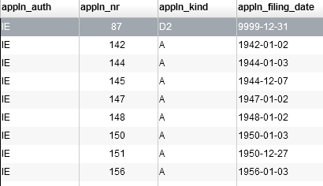
One more example
SELECT appln_auth, appln_nr, appln_kind, appln_filing_date
FROM tls201_appln
WHERE appln_auth = 'IE'
Result table (based on table tls201_appln )
FROM
SELECT
WHERE
Notes:
Just try it yourself!

Slide 19
Querying a single table

Slide 20
SELECT clause
The select clause may contain
a single attribute
a list of attributes, separated by comma
an asterisk (*), which stands for "all attributes of the table(s)"
Examples
SELECT appln_id
SELECT appln_auth, appln_nr, appln_kind, appln_filing_date
SELECT *
Notes:
Using the asterisk is very convenient when doing a quick query.
More complex forms of the SELECT clause will be covered later on in this paper.

Slide 21
Exercise:
Use the previous query to retrieve
several attributes of table tls201_appln
all attributes of this table
Note: The previous query was
SELECT ______________ FROM tls201_appln WHERE appln_auth = 'IE'
Notes:
Solutions:
1) Multiple solutions are possible:
SELECT appln_auth, appln_nr, appln_kind, appln_filing_date FROM tls201_appln WHERE appln_auth = 'IE'
Do not forget the commas which separate the attributes in the SELECT clause.
Note there is no comma after the last of these attributes.
2)
SELECT * FROM tls201_appln WHERE appln_auth = 'IE'

Slide 22
WHERE clause (1)
The WHERE clause contains one or more conditions.
The general form of a condition is:
<attribute or constant> <comparison operator> <attribute or constant>
The most common comparison operators and their meanings are
= equal
<> or != not equal
>, >= larger, larger or equal
<, <= smaller, smaller or equal
Typically, an attribute is compared to a constant. Examples:
appln_auth = 'IE' ← Strings must be enclosed in single quotes ( ‘ )
appln_id <> 1234711 ← Numbers are not enclosed in quotes
appln_filing_date >= '2001-01-01' ← Dates are enclosed in single quotes ( ‘ ) and take the form YYYY-MM-DD
You can also compare two attributes:
appln_filing_year = earliest_publn_year ← = Applications which are filed and published in the same year
Notes:
Strings and dates need to be enclosed in single quotes ( ' ).

Slide 23
Comparison operator: IN
Some of the following operators can be prefixed with the
keyword NOT to reverse their meaning.
IN, NOT IN
Tests whether the value of an attribute is contained in a list of values.
Examples:
appln_auth IN ('EP', 'JP', 'US') ← limit to Trilateral offices
appln_auth NOT IN ('US', 'CA') ← all offices except US and CA
Notes:
Please note how brackets, hyphens, commas, etc. are used in all examples.

Slide 24
Comparison operator: BETWEEN
BETWEEN, NOT BETWEEN
Tests whether the value of an attribute is between two values
Example:
appln_filing_date BETWEEN '2001-04-01' AND '2001-09-30'
Instead of BETWEEN, you can use the operators >= and <=
appln_filing_date >= '2001-04-01' AND appln_filing_date <= '2001-09-30'
Notes:
Examples of the two possibilities for a date range: Both queries of course return the same result (931 714 rows in the autumn 2014 edition).
SELECT *
FROM tls201_appln
WHERE appln_filing_date BETWEEN '2001-04-01' AND '2001-09-30'
SELECT *
FROM tls201_appln
WHERE appln_filing_date >= '2001-04-01'
AND appln_filing_date <= '2001-09-30'

Slide 25
Comparison operator: LIKE
LIKE, NOT LIKE
Tests whether two strings are similar. The %-wildcard represents zero, one or more characters (any characters)
Examples:
person_name LIKE 'SIEMENS%'
publn_kind LIKE 'A%'
ipc_class_symbol like 'B60K%'
appln_title LIKE '%hybrid%motor%'
Notes:
LIKE works on strings only, not on numbers or dates.
The %-wildcard may be inserted in any position of the string. However, a query with a wildcard on the left-hand side of the string will take much longer to execute than a trailing wild card. So do not use it unless you have to.
It is also possible to include multiple wildcards in a string, e. g. person_name LIKE '%SONY%'
The wildcard replacing exactly one character is the underscore (_).
LIKE allows also for more complex matching patterns, but these go beyond the scope of this paper. For example, LIKE '[0-9][0-9][0-9][0-9]‘ matches all 4-digit numbers (e. g. postal codes).
Unlike most Boolean queries (typically used in patent or literature databases), SQL does not support proximity operators. Boolean queries are tailored towards text data, whereas SQL is optimised for highly structured data.

Slide 26
WHERE clause (3)
The WHERE clause can contain more than one condition.
AND, OR and brackets can be applied as usual.
Example:
WHERE (appln_auth = 'EP' AND appln_filing_year = 2008) OR (appln_auth <> 'EP' AND appln_filing_year = 2010)
Notes:
You can break the query in any number of lines to improve readability.

Slide 27
Exercise:
Create a query to retrieve all Austrian patent applications filed since 2005.
Hints: - It is sufficient to use table tls201_appln only. - Don’t forget to exclude Austrian utility models - Exclude the filing year 9999 - When in doubt, check the Data Catalog
Notes:
SELECT appln_id, appln_nr, appln_auth, ipr_type, appln_filing_date FROM tls201_appln WHERE appln_auth = 'AT' AND ipr_type = 'PI' AND appln_filing_year >= 2005 AND appln_filing_year < 9999
Instead of typing, you can also drag and drop the name of a table or attribute to the query window.
If the query is not well formed, you will get an error message in the message box when you execute the query.
The result of this query executed in PATSTAT Online (autumn 2014 edition) returns : 122 461 rows.
This rather high number also contains EP patents which entered the Austrian national phase.
SELECT appln_id, appln_nr, appln_auth, ipr_type, appln_filing_date
You can list here any attribute of the table you use, in any order.
AND ipr_type = 'PI'
Retrieves only patents of invention (PI) and ignores utility models (UM)
AND appln_filing_year >= 2005 AND appln_filing_year < 9999
Returns all years from 2005 to today, while excluding the year 9999 (which stands for "date unknown"). You can also use “AND appln_filing_year BETWEEN 2005 AND 2014” instead.

Slide 28
TOP clause
You can limit the number of rows which will be retrieved.
Format: TOP immediately follows SELECT
TOP <number>
Example:
SELECT TOP 100 appln_id ← retrieve the first 100 rows FROM tls201_appln WHERE appln_auth = 'IE'
Note: Without explicit sorting (ORDER BY clause), the sample you will retrieve is not defined.
Notes:
The TOP clause is frequently used 1) if you are only interested in the first rows of an ordered result table (e.g. the top 10 of ...)
2) during testing. You can quickly retrieve some sample rows without having to load all of the data. This saves time and resources on the database server. However, once you have your query ready for some serious analysis, you should remove the TOP clause.

Slide 29
Exercise:
Retrieve (any) 1 000 rows of table tls209_appln_ipc .
Hint: You do not need the WHERE clause.
Notes:
Possible solution:
SELECT TOP 1000 *
FROM tls209_appln_ipc
The number of rows returned is - of course - always 1 000.

Slide 30
ORDER BY clause (1)
You can order the result table by one or more columns.
The ORDER BY clause is always at the end of a query.
Allowed formats:
ORDER BY <attribute> ← ascending order (default)
ORDER BY <attribute> asc ← ascending order
ORDER BY <attribute> desc ← descending order
list of attributes with any sort order ORDER BY <attribute> desc, <attribute> asc, ...
Notes:
Each column can have its own sort order: ascending (which is the default) or descending.
If multiple attributes are in the ORDER BY clause, then the first attribute is the primary sort criterion, the second attribute the secondary sort criterion, and so on.
Do not forget to separate each attribute from the next one by a comma.
Typically you will include all attributes of the ORDER BY clause also in the SELECT clause (probably even in the same order), because the result table is easier to comprehend if the rows are sorted according to some visible criteria. However, you are not forced to do this.

Slide 31
ORDER BY clause (2)
Example:
SELECT publn_date, publn_auth, publn_nr, publn_kind, pat_publn_id, appln_id
FROM tls211_pat_publn
WHERE publn_date BETWEEN '2011-05-01' AND '2011-05-14' ORDER BY publn_date, publn_auth desc, publn_nr
1. sort criteria, ascending
2. sort criteria, descending
3. sort criteria, ascending

Slide 32
Exercise:
Take any query and sort the result
- Sort according to multiple columns
- Try ascending or descending sort order

Slide 33
Querying multiple tables

Slide 34
Why do we need more than one table? (1)
My CD collection:
Madonna
Rolling Stones
Shakira
Problem of data redundancy:
Waste of storage space
Risk of inconsistency when data has to be updated (Grammys)
Notes:
When using tables (e.g. in Excel), many people put all information of interest in one table. This works fine if the information is not complex. Otherwise, the table gets messy.
The example shown represents a very small and simple CD collection. The owner created a very simple list to manage their six CDs by three artists. The approach makes sense for this size of database, but is not very scalable. There is redundant information (the birth places and the Grammy counter repeats if an artist has more than one CD), which causes:
waste of storage space – just imagine you would have to manage millions of entries
And, more importantly, a risk of introducing inconsistent data: e. g. if Madonna is awarded another Grammy, but you forget to update the Grammy counter in all three of her entries

Slide 35
Why do we need more than one table? (2)
Artists and albums are two different “things” (entities) which should be stored in separate tables.
The key (see underlined column) uniquely identifies one entry in a table. It is also called a “primary key” (PK).
Notes:
What the CD owner is doing now is called “data modelling”: defining how to structure the information, e.g. defining tables and deciding which information will be stored in which table.
Luckily, in PATSTAT this has already been done. But it helps to understand why it has been done this way.
The key (primary key (PK)) is an important concept in relational databases. A key uniquely identifies a single row in a table.

Slide 36
Why do we need more than one table? (3)
In real life, names and titles are often not unique.
A key could also be a combination of columns (e.g. first name, family name, birth date)
An ID can be added to guarantee uniqueness
A column which can be used to combine two tables is called a “foreign key” (FK). It is matched with the primary key of the other table.
Notes:
To reconstruct the complete single table from a previous slide we simply have to match the foreign key attribute (ARTIST_ID) of the table ALBUM with the primary key attribute (here also called ARTIST_ID) of the table ARTIST:
The artist Madonna matches with three albums
The artists Rolling Stones match with two albums
The artist Shakira matches with one album.
In total, this makes up the unified table with six rows that was discussed earlier, but without its drawbacks. There is no redundancy, because each piece of information is stored once (exception: the ARTIST_ID, but is it required to combine the two tables):
No storage space is wasted
Inconsistent data is not possible.

Slide 37
Why do we need more than one table? (4)
A little thought experiment: Reconstruct the original table (6 rows):
1) Combine every row of table 1 with every row of table 2 → 24 rows
2) Filter on all rows where the FK equals the PK → 6 original rows
Notes:
You can also visualise the logic of a join like this:
First combine every row of one table with every row of the other table. In our case, this would result in 3 x 6 = 18 rows.
Then, you select only rows where the FK (foreign key) of the one table is equal to the PK (primary key) of the other table. This is the case for six rows (marked with colour), which are exactly the same six rows as from the original table shown earlier on a slide.
Now let’s try another thought experiment: combining the application table TLS201_APPLN with the title table TLS202_APPLN_TITLE: First combine every row of the first table with every row of the second table. In our example, this would result in 80 000 000 x 60 000 000 rows, i.e. about 4 800 trillion rows, which, of course, is unmanageable for every real database. Then you select only those rows which fulfil the join restriction you defined (matching FK with PK) to create a table which contains application data as well as title data. Note: Luckily, in practice the database system will compute it more efficiently by applying all sorts of optimisations, but the result will be the same.

Slide 38
Links between tables (1)
In PATSTAT, patent data is broken down into multiple tables. So you will typically have to query multiple tables to get useful answers.
Luckily, tables can be joined. The JOIN is a very powerful feature of SQL and you will use it for most queries.
One JOIN clause can connect two tables. To connect multiple tables, multiple JOIN clauses must be used.
Notes:
Not only PATSTAT, all non-trivial databases consist of several tables.
The reason for not having just one big table is to reduce data redundancy.
Example: One application may have 0, 1 or more (usually more) IPC symbols.
So to have application data and IPC data in one big table, you would need to have one row for each IPC symbol of each application. As a consequence, the application data would be stored multiple times, which would result in a waste of disk space / main memory and make updates error-prone.

Slide 39
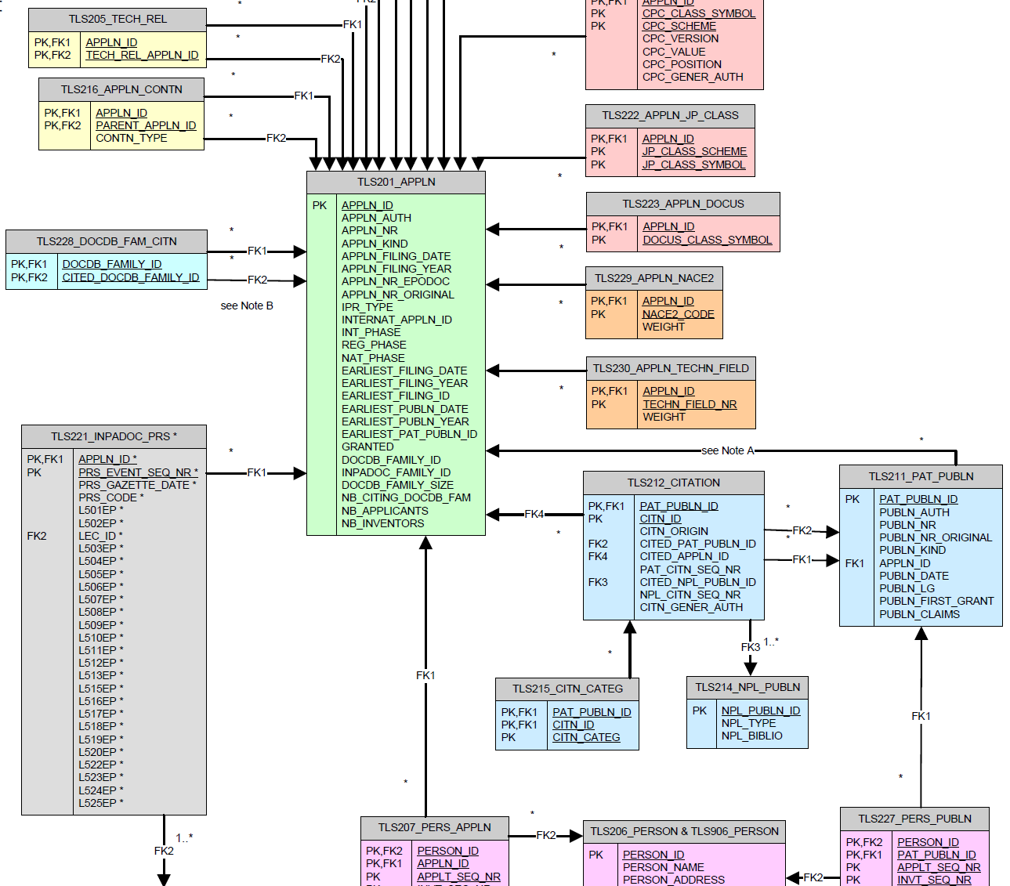
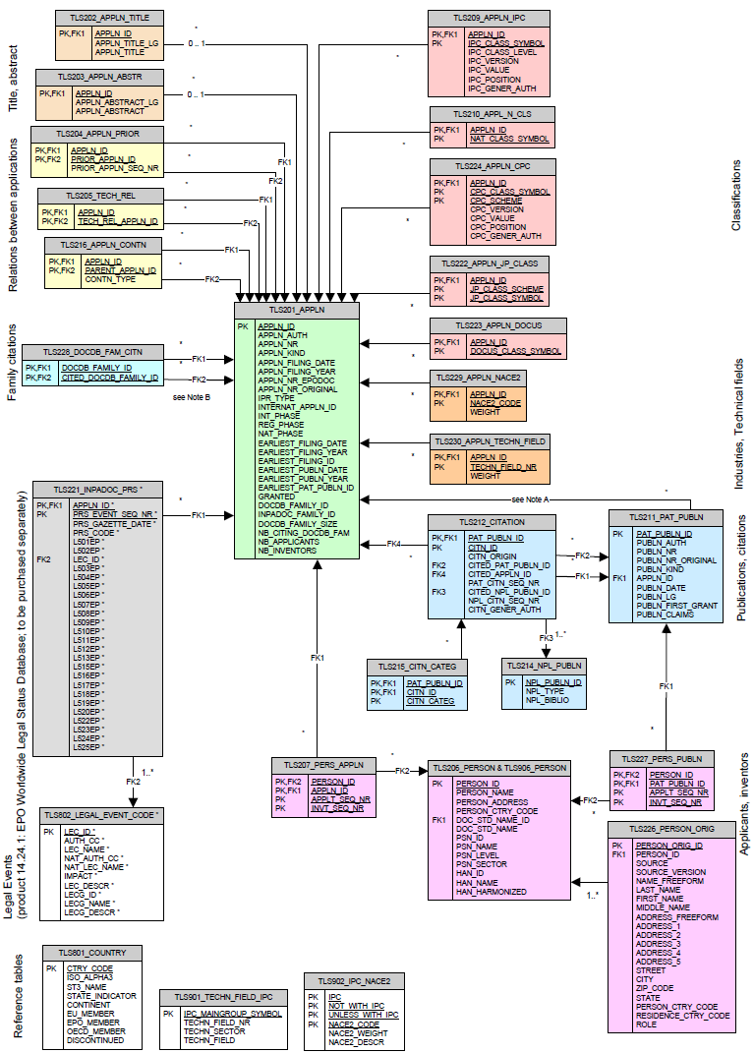
PATSTAT data model
The data model shows tables (as boxes) and their logical connections (as lines).
Notes:
See section 3 of the Data Catalog for this chart.

Slide 40
Links between tables (2)
How tables can be joined in a meaningful way is defined in the Data Catalog.
Notes:
The PATSTAT data model is designed in such a way that - where feasible and sensible - the attributes of the two joining tables have the same name.
This is possible in Example 1, but not in Example 2.
Also, in most cases, tables are joined via an ID attribute. Remember that IDs have no business meaning, e.g. the application ID (attribute appln_id) is just a unique number and must not be confused with the application number (appln_nr), which is required to identify an application in the real world.
Example 1: The attribute appln_id of table tls202_appln_title can be joined with attribute appln_id of table tls201_appln.
Example 2:
There are 3 attributes in table tls204_appln_prior (Paris Convention priorities): appln_id: ID of the applications whose priorities are stored here
prior_appln_id: ID of a priority application (Note: There might be several priority applications; each one would be in a row of its own). If you need to find the priority date of the application, just retrieve the filing date of the priority application.
prior_appln_seq_nr: This number indicates whether this is the 1st, 2nd, 3rd, etc. priority application of this application
There are two attributes in this table which can be used to join other tables.
1) The attribute appln_id of table tls204_appln_prior can be joined with attribute appln_id of table tls201_appln.
2) The attribute prior_appln_id of table tls204_appln_prior can also be joined with attribute appln_id of table tls201_appln.

Slide 41
Links between tables (3): person tables
Fragment of the real database (Oct. 2011 version)
tls201_appln
appln_id
appln_auth
appln_nr
ipr_type ...
56
EP
040005863
PI
tls207_pers_appln
person_id
appln_id
applt_seq_nr
invt_seq_nr
27177351
56
0
3
33799676
56
1
0
tls206_person
person_id
person_ctry_code
person_name
27177351
DE
Pompe, Wolfgang
33799676
DE
Technische Uni..
Join possibility
Notes:
This is an example where multiple tables are joined.
Usually ID attributes will be joined but, technically, the name of the attributes are not important.
Look especially for these attributes (examples): - appln_id - person_id - pat_publn_id - citn_id - family_id
If you are working with the names of applicants or inventors, you will very often need to join the tables
- tls201_appln - tls207_pers_appln and
- tls206_person
as shown above. So it will pay off to remember this situation.
As you know, one patent may have multiple applicants / inventors, and each applicant / inventor may be associated with multiple applications.
Using some technical jargon, we speak of an "m-to-n relationship".
If we want to model such an m:n relationship of the real world in a relational database, we need three tables:
- One table contains the applications (tls201_appln)
- Another table contains the applicants / inventors (tls206_person)
- The third table is the linking table (tls207_pers_appln), which contains the information on which application is related to which applicant/inventor.

Slide 42
JOIN clause (1)
SELECT *
FROM tls202_appln_title
JOIN tls201_appln ON tls202_appln_title.appln_id = tls201_appln.appln_id
WHERE appln_title LIKE 'bicycle transmission%'
The JOIN clause specifies the table to be joined with the other tables in the queries.
The join condition (ON part of the JOIN clause) specifies the attributes which should be joined.
Notes:
Instead of JOIN, you could also write INNER JOIN. This is just a different syntax; the result will be the same. This is in contrast to an OUTER JOIN, which will be presented later.
As in any other query, the result of a join is another table. A “SELECT * “ will retrieve all attributes of all joined tables.
E.g. in our example, the appln_id appears twice, the first time from table tls202_appln_title, the second time from table tls201_appln. Their values are identical, because in the join condition we required them to be identical.
There are several types of JOINS and several variations in syntax in SQL Server:
- (INNER) JOIN: This is the join described on this slide.
LEFT (OUTER) JOIN, RIGHT (OUTER) JOIN, FULL (OUTER) JOIN: these will be discussed later.
Note: The keywords in brackets are optional, e.g. an inner join can be written as “JOIN ..” or as “INNER JOIN ..” . Both have the same meaning.
Note: NATURAL JOINs are not supported in MS SQL Server, so they are not discussed here.
We will only discuss the ones which are most commonly used.
In practice, you always require that the attributes to be compared are equal. But in special cases and for advanced usages, other comparisons (non-equi joins, e. g. ... ON attribute_a > attribute_b) ...) might be useful.

Slide 43
Table alias - Giving tables a short name
Table names are quite long
You can assign tables a short alias name
Aliases are specified in the query and only valid within the scope of the query
Aliases have to be written directly after the table name
→ Queries are easier to read
SELECT *
FROM tls202_appln_title t
JOIN tls201_appln a ON t.appln_id = a.appln_id
WHERE appln_title LIKE 'bicycle transmission%'
Note: Once a table alias is used, you cannot refer to the table by its full name within the same query.
Notes:
The example above is just the following query rewritten using table aliases:
SELECT *
FROM tls202_appln_title
JOIN tls201_appln ON tls202_appln_title.appln_id = tls201_appln.appln_id
WHERE appln_title LIKE 'bicycle transmission%'
Note: If an alias is assigned to a table, all explicit references to the table in the Transact-SQL statement must use the alias, not the table name. So this query is syntactically not correct: SELECT *
FROM tls202_appln_title t
JOIN tls201_appln ON tls202_appln_title.appln_id = tls201_appln.appln_id
WHERE appln_title LIKE 'bicycle transmission%'
A table alias can consist of one or more characters
Generally I use a very short abbreviation of the table name, like
tls201_appln a
tls209_appln_ipc i
tls206_person p
tls211_pat_publn p (of course, I use a different name. e. g. pub, if in the same query also tls206_person is used)
tls207_pers_appln pa
...
Of course this is a matter of personal style.

Slide 44
Identification of attributes (1)
If an attribute is unique within all tables of a query, it is sufficient to use only the (unqualified) attribute name. Examples: appln_id ipc_class_symbol
If the same attribute name is used in multiple tables of a query, you must use the qualified form. Table name and attribute name are connected with a dot: <table name>.<attribute name> Examples: tls201_appln.appln_id tls211_appln_ipc.ipc_class_symbol
Notes:
As a rule of thumb: If you use a query with a JOIN, you will often need to qualify the attribute, at least for the JOIN attribute. Example:
SELECT *
FROM tls202_appln_title
JOIN tls201_appln ON tls202_appln_title.appln_id = tls201_appln.appln_id
-- here the qualified attribute name is required
WHERE appln_title LIKE 'bicycle transmission%'
-- here it is sufficient to use the unqualified attribute name

Slide 45
Identification of attributes (2)
If you have defined a table alias, you must use this table alias and not the table name for qualified attribute names. Examples: a.appln_id i.ipc_class_symbol
This will also make your queries easier to read.
Notes:
Here is the previous example with table aliases:
SELECT *
FROM tls202_appln_title t
JOIN tls201_appln a ON t.appln_id = a.appln_id
-- here the qualified attribute name is required
WHERE appln_title LIKE 'bicycle transmission%'
-- here it is sufficient to use the unqualified attribute name

Slide 46
JOIN clause (2)
SELECT *
FROM tls209_appln_ipc
JOIN tls201_appln ON tls209_appln_ipc.appln_id = tls201_appln.appln_id
WHERE tls209_appln_ipc.appln_id = 456789
A single application may have 0, 1 or more IPC symbols (1:n relationship)
Restricting the query to one application still retrieves several rows, with an identical application part
Notes:
Note on the result table:
- The attribute appln_id occurs twice, once for each table.
- The values of these appln_id attributes are identical (because that is what we specified in the join restriction)
- Each IPC symbol requires a separate row. Because each value is "elementary", the design does not allow for storing three IPC symbols in one field of a single row.
- The application data in tls201_appln is repeated for each of its IPC symbols

Slide 47
Exercise:
Run this query, which is similar to the previous one. It retrieves the IPC symbols of three applications:
SELECT *
FROM tls209_appln_ipc i
JOIN tls201_appln a ON i.appln_id = a.appln_id
WHERE a.appln_id IN (456789, 456790, 456791)
How many rows do you get? How many applications? How many IPC symbols per application?
Notes:
You get seven rows, each representing one IPC symbol of an application.
There are of course three applications, because each of the three application IDs we selected identifies exactly one application.
The applications have 2-3 IPS symbols each:
Application 456789 has 3 IPC symbols
Application 456790 has 2 IPC symbols
Application 456791 has 2 IPC symbols

Slide 48
Exercise:
Write and run a query which joins the tables tls201_appln, tls207_pers_appln, tls206_person.
The Data Catalog tells you how to join the tables.
Use table aliases.
Restrict the result to - applications with Russian (RU) application authority and - with applicants / inventors from Spain (ES)
Notes:
Hint: You need three Joins to join four tables:
SELECT *
from tls201_appln a
JOIN tls207_pers_appln pa on a.appln_id = pa.appln_id
JOIN tls206_person p on pa.person_id = p.person_id
where p.person_ctry_code = 'ES'
and a.appln_auth = 'RU'

Slide 49
Exercise:
Re-write the previous query (4-table join) but retrieve only these columns:
person_name and doc_std_name of table tls206_person and all columns of table tls201_appln
Notes:
SELECT p.person_name, p.doc_std_name, a.*
from tls201_appln a
JOIN tls207_pers_appln pa on a.appln_id = pa.appln_id
JOIN tls206_person p on pa.person_id = p.person_id
where p.person_ctry_code = 'ES'
and a.appln_auth = 'RU'

Slide 50
INNER JOIN vs. OUTER JOIN
So far, we have discussed only INNER JOINs.
The INNER JOIN returns corresponding rows in two tables. A row in the left table with no corresponding row in the right table (or vice versa) is not retrieved.
OUTER JOIN also returns rows which do not have a corresponding row in the other table. The attributes in the replenished rows of the other table contain the value NULL.
SELECT i.*, a.*
FROM tls201_appln a
JOIN tls209_appln_ipc i ON a.appln_id = i.appln_id
WHERE a.appln_id = 364137181
This query returns no rows, because the selected application does not have IPC symbols.
Notes:
You can prove that the application does exist: SELECT *
FROM tls201_appln
WHERE appln_id = 364137181
Nevertheless, it does not have any IPC symbols assigned.
Note: NULL is a special value meaning "undefined", "do not know", "not applicable" or similar. Any attribute of any data type (number, date, string, etc.) can be NULL, unless NULL has been disallowed for certain columns by the database designer. Luckily, to make things easier, the PATSTAT data model does not contain any NULLs.
A NULL value is not the same as a string "NULL". Nevrtheless, to display NULL values, most databases show the "NULL"-string or an empty string on the screen / in a file.
In the Table Window, PATSTAT Online displays NULL values as a string containing “NULL”.

Slide 51
OUTER JOIN
SELECT i.*, a.*
FROM tls201_appln a
LEFT OUTER JOIN tls209_appln_ipc i ON a.appln_id = i.appln_id
WHERE a.appln_id = 364137181 -- same application as on the previous slide
tls201_appln is the left table, tls209_appl_ipc is the right table.
The LEFT OUTER JOIN retrieves for all rows of the left table the matching rows of the right table and - if there are no matching rows - NULL values.
Although the application has no IPCs, it is retrieved.
Notes:
The left table is the table on the left-hand side of the JOIN keyword; the right table is therefore the table on the right-hand side of the JOIN keyword.
The order of the attributes in the SELECT clause is not relevant (in effect, in the example above, the attributes of the right table are displayed first, followed by the attributes of the left table).
If you are JOINing multiple tables, esp. when mixing INNER and OUTER, LEFT and RIGHT joins, you may want to use brackets to group / nest the JOINs - or if possible reformulate your query.
The OUTER keyword is optional, i.e. LEFT JOIN and LEFT OUTER JOIN is equivalent. Typically, the latter form is used, to make it explicit that an OUTER JOIN is used.
There is also a RIGHT OUTER JOIN, which works analogously. Typically the LEFT keyword is used more frequently.
For vey special cases there is also a FULL OUTER JOIN.

Slide 52
SELECT clause revisited
The select clause may contain
a single attribute
a list of attributes, separated by a comma: The attributes may be qualified or unqualified
an asterisk (*), which stands for "all attributes of the table(s)"
an asterisk preceded by a table name / table alias which stands for "all attributes of this table"
a list of any of the above, separated by comma
Examples
SELECT appln_id
SELECT appln_auth, appln_nr, appln_kind, appln_filing_date
SELECT a.appln_id, tls212_citation.citn_origin
SELECT *
SELECT p.*, tls201_appln.*, i.ipc_class_symbol
Notes:
This is an enhancement of a previous slide discussed in one of the foregoing sections. The added parts are printed in bold.

Slide 53
Grouping, counting and aggregating rows

Slide 54
What is a grouping? (1)
Using the table shown on a previous slide, we can define groups e.g. by the ARTIST column:
There are three groups (here: colour coded), which can be described:
by their size: “Madonna” has three rows, Shakira has one row
by their group column
but NOT by any other column
Notes:
One can imagine that all rows which do have the same group column are squeezed together into a single grouped row
Their content consists only of the grouped column: All other columns may be different (e. g. album title), but they need not be (e. g. birth place)
The “size” of the group: We know how many rows have been squeezed into a single row.
The groups can be represented by a single table having just one column (the group column ARTIST) with three rows. It would look like this
ARTIST
---------
Madonna
Rolling Stones
Shakira

Slide 55
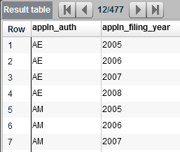
GROUP BY clause (1)
SELECT appln_auth, appln_filing_year
FROM tls201_appln
WHERE appln_filing_year BETWEEN 2005 AND 2008
GROUP BY appln_auth, appln_filing_year
ORDER BY appln_filing_year, appln_auth
The GROUP BY is followed by one or more attributes.
All rows which have the same values for these attributes are compressed into 1 row
Notes:
GROUP BY is a very powerful construct for statistical analysis as you will soon see.
Note:
- The order of the attributes in the GROUP BY clause is not relevant
- The GROUP BY clause is after the WHERE clause and before the ORDER BY clause
Here you see a line for every office and year where one or more applications have been filed.
It comes as no surprise that most offices have at least one application each year.

Slide 56
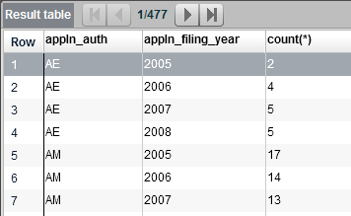
GROUP BY clause (2)
SELECT appln_auth, appln_filing_year, COUNT(*)
FROM tls201_appln
WHERE appln_filing_year BETWEEN 2005 AND 2008
GROUP BY appln_auth, appln_filing_year
ORDER BY appln_auth, appln_filing_year
The count(*) returns the number of rows (here: applications) which are compressed into a single row by the GROUP BY clause (here: filing year and office)
Put more simply: This query computes the number of applications per office and filing year.
Notes:
The real power of GROUP BY is tapped when you use them with an aggregate function like COUNT() (see also later slides).
This simple count tells you that some offices have very low filing figures per year, while others have quite high ones.
Note that the name of the third column in the result table is "count(*)". Soon you will learn how to give columns a more readable name of your choice.

Slide 57
GROUP BY clause (3)
When using GROUP BY, the SELECT clause may only contain
attributes listed in the GROUP BY clause or
aggregated attributes, such as COUNT ()
Example of an invalid query: SELECT appln_auth, appln_filing_year, COUNT(*), appln_id, appln_filing_date FROM tls201_appln WHERE appln_filing_year BETWEEN 2005 AND 2008 GROUP BY appln_auth, appln_filing_year ORDER BY appln_auth, appln_filing_year
Notes:
In the query above:
- appln_auth, appln_filing_year:
These attributes are also mentioned in the GROUP BY clause
- COUNT(*) is an aggregate function. Count and other functions will be discussed later. - appln_id, appln_filing_date
are not mentioned in the GROUP BY clause, nor are they an aggregate function. So a syntax error message is triggered.

Slide 58
Exercise:
Write a query which, for Danish (DK) applications, returns the number of applications per publication year of the first publication. The order should be chronologically reversed (most recent on top).
Hint: Consider attribute tls201_appln.publn_earliest_year
Notes:
Possible solution:
SELECT COUNT(*), publn_earliest_year
FROM tls201_appln
WHERE appln_auth = 'DK'
GROUP BY appln_auth, publn_earliest_year
ORDER BY publn_earliest_year desc

Slide 59
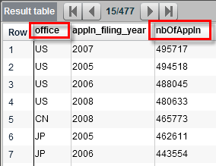
Attribute Aliases
SELECT appln_auth AS office, appln_filing_year, COUNT(*) AS nbOfAppln
FROM tls201_appln
WHERE appln_filing_year BETWEEN 2005 AND 2008
GROUP BY appln_auth, appln_filing_year
ORDER BY nbOfAppln desc
You can rename any column in the SELECT clause by adding AS <alias> after each attribute / aggregated attribute
This is often used to rename computed attributes
The alias can be utilised in the ORDER BY clause, but not in the WHERE clause
Notes:
The reason you cannot use attribute aliases in the WHERE clause: when the system processes the WHERE clause restrictions, the attribute has not yet been renamed to the alias.

Slide 60
Aggregate functions: Counting, …
Aggregate functions work on a set of values and return a single value.
When there is no GROUP BY clause, the function works on the complete result table
When there is a GROUP BY clause, the function works on each group separately
COUNT() Number of rows containing a Non-NULL value
SUM() Sum
AVG() Average
MIN() Minimum
MAX() Maximum
STD() Std. deviation
Notes:
There are many more aggregation functions in SQL Server, many of them for very special purposes. On this, please consult more detailed documentation.
Different database management systems may have different functions, but they have all implemented COUNT(), MIN(), MAX() or AVG().

Slide 61
Arguments of aggregate functions
An aggregate function requires an argument, which can be:
an asterisk (*): This is the most common form, e.g. COUNT(*) → the function is applied on all rows (of a group)
an attribute: E. g. SUM(publn_claims) → the function is applied on all rows (of a group) which have a value other than NULL¹ in that attribute
DISTINCT <attribute> E. g. COUNT(DISTINCT appln_auth) → the function is applied on all rows (of a group) but considers each value of the attributes only once²
¹ NULL is a special value which is used to express "do not know", "not applicable" or the like, but which is neither zero nor empty. See also the section on OUTER JOINs. ² See also the slide on the DISTINCT keyword
Notes:
Example:
Retrieve for all offices
- the number of applications and
- the number of different languages used in the titles
for a specific year (let's say 2010)
SELECT appln_auth, COUNT(*) AS nbOfApplications, COUNT(DISTINCT appln_title_lg) AS nbOfDistinctTitleLg
FROM tls201_appln
WHERE appln_filing_year = 2010
GROUP BY appln_auth
114 rows are retrieved (in autumn 2014 edition), one row for each country.

Slide 62
Exercise:
Write a query which retrieves all Swiss (CH) applications per filing year: - the number of applications - the average number of applicants per application - the maximum number of applicants per application
Give all attributes descriptive aliases.
Hint: Make use of the available pre-computed attributes in PATSTAT. Hint: Use “AVG(nb_applicants *1.0 )” in the SELECT clause to return the average as a decimal number (without rounding).
Notes:
Possible solution:
SELECT appln_filing_year, COUNT(*), AVG(nb_applicants *1.0 ) AS averageApplicants, MAX(nb_applicants) AS maximumApplicants
FROM tls201_appln
WHERE appln_auth = 'CH'
GROUP BY appln_filing_year
ORDER BY appln_filing_year desc
You see that before 1999 the average number of applicants is less than one, which must mean that we do not have applicants for every application. If necessary, you could investigate this further, e.g.:
SELECT appln_filing_year, COUNT(*)
FROM tls201_appln
WHERE appln_auth = 'CH'
and nb_applicants = 0
GROUP BY appln_filing_year
ORDER BY appln_filing_year desc

Slide 63
Aggregate function STRING_AGG()
This is another, often very handy aggregate function.
It puts all attribute values of a group into a single value.
Numbers, dates, etc. are automatically converted to strings.
User-defined separators are put between individual values.
The simplified syntax is: STRING_AGG (attribute, separator)
Example:
SELECT appln_id, STRING_AGG(ipc_class_symbol, ', ‘) FROM tls209_appln_ipc WHERE appln_id between 10000200 and 10000202 GROUP BY APPLN_ID
Notes:
For more complex examples, see Microsoft’s documentation by searching the internet with “T-SQL” and “STRING_AGG”): For example, with STRING_AGG() you can also sort the values within the aggregated string.
SELECT appln_id, STRING_AGG(ipc_class_symbol, ', ‘) FROM tls209_appln_ipc WHERE appln_id between 10000200 and 10000202 GROUP BY APPLN_ID
The query above returns the result below in PATSTAT Online (autumn 2019 edition). The second column contains a list of all IPC symbols of the respective application. The IPC symbols within a list are separated by a comma and a space.
appln_id (No column name)
10000200 A23C 9/123, A23C 19/032, A23C 21/02
10000201 C08F 2/00, C08F 14/00, C08F 14/06
10000202 A23F 3/06, A23F 3/26, A23F 5/48, A23L 3/44, A23L 27/10

Slide 64
Exercise:
Write a query which retrieves a list of all countries for each continent.
Hint: All necessary information is in table TLS801_COUNTRY.
You may use one of these attributes: - CTRY_CODE two-character code of WIPO ST.3 - ISO_ALPHA3 three-character code - ST3_NAME the short English name
Notes:
Possible solution:
SELECT continent, STRING_AGG (ST3_NAME, ' - ')
FROM tls801_country
GROUP BY continent

Slide 65
Filtering on groups
Example: Groups defined by artist
Besides the data in the group columns, groups have certain characteristics which can be used to filter them.
Examples:
size of group
latest album release year
Notes:
This example shows a table grouped by artist. It contains three groups, each shown in a different colour.
By a “characteristic” we mean a single value which describes a group, e.g.
- size (= counting the number of element of each group: e. g. the MADONNA group has a count of three, the SHAKIRA group has a count of one)
earliest release year of an album (1986 for the MADONNA group, 2014 (there is only one album) for the SHAKIRA group)
another (perhaps weird) example: average length of the title for each group. For the MADONNA group this would be (15 + 9 + 11) / 3 = 11.66 characters
many more of these “aggregate functions” are conceivable. We have discussed the most important aggregate functions l(COUNT, MIN, MAX, AVG, STRING_AGG) earlier in this paper.

Slide 66
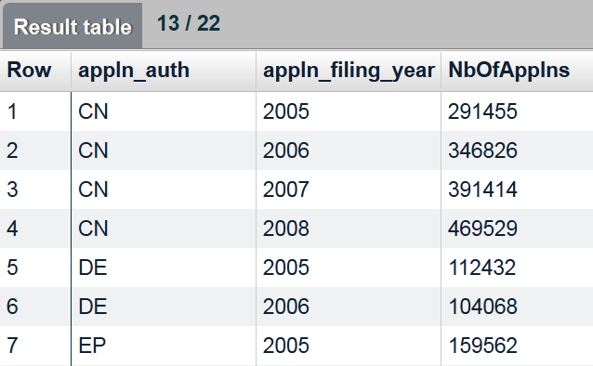
HAVING clause
SELECT appln_auth, appln_filing_year, COUNT(*) as NbOfApplns
FROM tls201_appln
WHERE appln_filing_year BETWEEN 2005 AND 2008
GROUP BY appln_auth, appln_filing_year
HAVING COUNT(*) > 100000
ORDER BY appln_auth, appln_filing_year
Purpose is to restrict aggregated values of a group
Accepts conditions like in the WHERE clause
To be used together with a GROUP BY clause
HAVING clause is positioned directly after the GROUP BY clause
Notes:
This is already a rather advanced concept, which you are unlikely to apply on a day-to-day basis.
You should use HAVING when you want to put a restriction on grouped attributes (like "COUNT(*) as NbOfApplns"). In all other cases, you should use the already familiar WHERE clause.
As expected, the example query retrieves the IP5 offices, plus two strong years for the German office.

Slide 67
Exercise:
Write a query which retrieves all Austrian (AT) applications filed in the year 2006 which have been published more than twice.
Hints: - Join the application table with the publication table. - use GROUP BY and HAVING
Notes:
Possible solution:
SELECT COUNT(a.appln_id) AS nbOfPublns, a.appln_id
FROM tls201_appln a
JOIN tls211_pat_publn p ON a.appln_id = p.appln_id
WHERE appln_auth = 'AT'
AND appln_filing_year = 2006
GROUP BY a.appln_id
HAVING nbOfPublns > 2
ORDER BY nbOfPublns desc

Slide 68
Subqueries

Slide 69
Subqueries
A subquery is a query which is nested within an outer query.
SELECT *
FROM tls211_pat_publn
WHERE publn_claims =
(SELECT MAX(publn_claims)
FROM tls211_pat_publn )
Subqueries are always put in brackets
Subqueries may or may not be correlated to the outer query
Subqueries are often a simpler alternative way to formulate a query.
Notes:
This query returns (in the autumn 2014 edition) a single publication, which has (the surprisingly high number of) 887 claims.
First the result of the nested query is computed, which returns a single row with a single value. In our case it is 887, the maximum number of claims of all publications. Then the outer query retrieves all publications which have 887 claims. One publication (= one row of table tls211_pat_publn) is retrieved because only one publication has 887 claims.
The current query is not correlated to the outer query. Examples of correlated queries are given on the next slides.
There are several reasons why subqueries are useful (source http://dev.mysql.com/doc/refman/5.1/en/subqueries.html)
- They allow queries which are structured in such a way as to isolate each part of a statement.
- They provide alternative ways to perform operations that would otherwise require complex joins and unions.
- Many people find subqueries more readable than complex joins or unions.

Slide 70
Subquery in the SELECT clause
A subquery in the SELECT clause must always return a single value of a single row.
SELECT publn_nr, publn_date,
(SELECT appln_filing_date
FROM tls201_appln a
WHERE p.appln_id = a.appln_id -- correlates outer and nested query
) as filingDate
FROM tls211_pat_publn p
WHERE publn_auth = 'NL'
The subquery is correlated with the outer query by "WHERE p.appln_id = a.appln_id"
Notes:
This query returns (in the autumn 2014 edition) 634 260 rows.
The third attribute of the SELECT list is a subquery and will be named "filingDate". The subquery is correlated with the outer query by "WHERE p.appln_id = a.appln_id".
This works like a JOIN, and in fact this subquery replaces a JOIN. For each publication, the subquery returns a single value (column tls201_appln.appln_filing_date) of a single row (because every publication belongs to exactly one application)
Note that in many cases a JOIN may be more efficient than a subquery, but this depends on many factors. So, if performance is an issue for you, you should first do some tests.

Slide 71
Subquery in the WHERE ... IN clause
The IN operator checks whether a value falls within the set of values retrieved by the subquery.
SELECT appln_auth, appln_nr, appln_kind
FROM tls201_appln a
JOIN tls209_appln_ipc i ON a.appln_id = i.appln_id
WHERE ipc_class_symbol IN
(SELECT ipc_class_symbol
FROM tls209_appln_ipc
WHERE appln_id = 100072)
The query above retrieves all applications which have at least one IPC symbol in common with a specific other application.
Notes:
Note that we discussed the IN / NOT IN comparison operator earlier. Instead of comparing an attribute with a static set of values, we check whether a value is contained in a set of values – all IPC symbols of a given application - returned by a subquery.
This query returns (in the autumn 2014 edition) 23 484 rows.
The application with appln_id 100072 has 2 IPC symbols: 'B60K 1/00' and 'B60W 30/18'. You can check this with this query:
SELECT ipc_class_symbol
FROM tls209_appln_ipc
WHERE appln_id = 100072

Slide 72
Subquery in the WHERE ... EXISTS clause
The EXISTS operator checks whether the subquery retrieves any row at all. The subquery can return any number of rows or values.
SELECT appln_auth, appln_nr, appln_kind
FROM tls201_appln a
WHERE EXISTS
(SELECT * FROM tls209_appln_ipc i
WHERE a.appln_id = i.appln_id
AND ipc_class_symbol = 'B60K 1/00')
AND EXISTS
(SELECT * FROM tls209_appln_ipc i
WHERE a.appln_id = i.appln_id
AND ipc_class_symbol = 'B60W 30/18')
The query above retrieves all applications which have at least these two IPC symbols.
Notes:
The subquery in a WHERE ... EXISTS clause is usually correlated with the outer query.
This query returns (in the autumn 2014 edition) 69 rows.
The query checks for each IPC symbol separately whether an application has these symbols. If an application has both symbols, it is retrieved.
The subquery is correlated with the outer query: a.appln_id = i.appln_id. Note that both subqueries use the table alias "i" for table tls209_appln_ipc. However, there is no name confusion because the two subqueries are independent of each other.
There is also a negation of the EXISTS operator: NOT EXISTS is true if the subquery does not return any row.

Slide 73
More useful SQL features

Slide 74
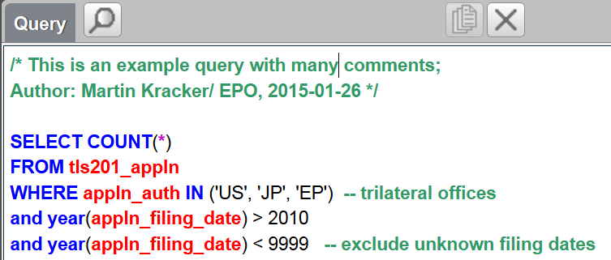
Comments
A comment is a text which is ignored by the query engine. In other words, you can write anything you find useful.
A comment is ...
everything between /* .. */
everything coming after two minus signs -- until the end of the line
Notes:
Comments will help others (and very often yourself!) to understand your queries.
It is best not to document WHAT you have done, but WHY you have done it.

Slide 75
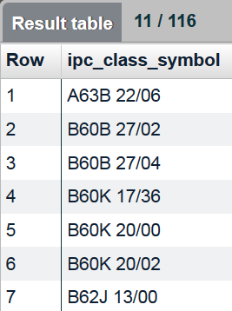
DISTINCT keyword
SELECT DISTINCT ipc_class_symbol
FROM tls202_appln_title t
JOIN tls209_appln_ipc i ON t.appln_id = i.appln_id
WHERE appln_title LIKE 'bicycle transmission%'
ORDER BY ipc_class_symbol
DISTINCT removes duplicate rows
DISTINCT follows directly after the SELECT keyword
Notes:
DISTINCT has already been introduced earlier in the context of aggregate functions.
Here, DISTINCT applies to complete lines of the returned table, and only DISTINCT rows are shown.
The query retrieves all distinct (= unique) IPC symbols which are assigned to applications whose title starts with "bicycle transmission" and it returns 116 rows (in the autumn 2015 edition).
Without the DISTINCT clause, it would return 444 rows. Try it out.

Slide 76
Functions
Functions can be extremely useful.
A function takes an attribute (and sometimes a list of attributes) as argument.
A function returns a single value
In a query, you always can replace an attribute with a function
SELECT TOP 100 UPPER(person_name) + '; ' + person_ctry_code
FROM tls206_person
WHERE CHARINDEX('SONY', person_name) = 0
-- SONY must not be part of the name
AND LEN(RTRIM(LTRIM(person_address))) >= 20
-- It is assumed that only addresses with more than 20 characters are complete
Notes:
There are many more functions in SQL Server than are mentioned here. For a complete list, see e. g. https://msdn.microsoft.com/en-us/library/ms174318.aspx.
The example query on this slide does not make much sense, but it shows quite a lot of the string functions discussed on the next slides.
A preliminary explanation of the functions used in the query:
UPPER(attribute): returns the string-valued attribute in upper case
string1 + string2: concatenates the strings and returns a single string
CHARINDEX(match-string, string): checks whether the match-string is part of the string
LTRIM(attribute): returns the string-valued attribute without leading spaces (left trim)
RTRIM(attribute): returns the string-valued attribute without trailing spaces (right trim)
LEN(attribute); returns the number of characters of the string-valued attribute
AS you can see in the last line of the query, functions can be nested: LEN(RTRIM(LTRIM(person_address)))

Slide 77
String functions (1)
String functions work with string attributes.
person_name + '; ' + person_ctry_code: Use the plus sign to concatenate multiple strings into one string
LEN(appln_title) returns length of a string
UPPER(person_name) , LOWER(person_name) returns the string in upper / lower case
LTRIM(person_address) / RTRIM(person_address) returns the string without leading / trailing spaces.
Notes:
There are many more functions in MySQL than are mentioned here. For a complete list, see e. g. http://dev.mysql.com/doc/refman/5.0/en/functions.html
Other database management systems typically have the same functionality, but the names and syntax are often different.
E.g. LENGTH() in MySQL is named LEN() in MS SQL Server. CHAR_LENGTH() is equivalent to LENGTH() but also works correctly with multibyte characters.

Slide 78
String functions (2)
CHARINDEX('SONY‘, person_name) returns the position where the string SONY is located in person_name. Zero is returned if SONY is not found.
SUBSTRING(ipc_class_symbol, 5, 4) returns four characters starting with the 5th (=main group)
LEFT(ipc_class_symbol, 4) returns the first four characters (= IPC subclass)
REPLACE(person_address, 'Wien', 'Vienna') returns a string where all occurrences of 'Wien' are replaced by 'Vienna'

Slide 79
Datetime functions
These functions work with date attributes.
GETDATE() requires no argument and returns the current date
DATEADD(month, 18, appln_filing_date) DATEADD(month, -18, appln_filing_date) adds / subtracts 18 month to/from the filing date; it can also be used to add years, days, etc.
YEAR(appln_filing_date) MONTH(appln_filing_date) DAY(appln_filing_date) returns the specified part of the date

Slide 80
Arithmetic operators
You can do the usual maths with number attributes or constants.
SELECT top 100 appln_auth, appln_nr, appln_kind, nb_applicants, nb_inventors, nb_citing_docdb_fam,
earliest_publn_year - appln_filing_year as yearsToPublish,
(nb_applicants * 10 + nb_inventors) * nb_citing_docdb_fam / 2.0 as myIndicator
FROM tls201_appln
+ add
- subtract
* multiply
/ divide
% modulo (the remainder of a division)
To force a result in decimal format, make sure that at least one argument is in decimal format: e.g. nb_citations / 2.0
Notes:
If in doubt as to which operator takes precedence, use brackets.
Try this query and see how the attributes yearsToPublish and myIndicator are computed.

Slide 81
Frequently used JOINs

Slide 82
Titles and abstracts
Each application has either one or no title / abstract. Sometimes the title/abstract is missing, so OUTER JOIN is used.
SELECT a.appln_id, appln_auth, appln_nr, appln_kind, t.appln_title
FROM tls201_appln a
LEFT OUTER JOIN tls202_appln_title t ON a.appln_id = t.appln_id
WHERE -- please complete ....
Notes:
Unless you want to retrieve all 80m applications (not recommended!), add a sensible restriction in the WHERE clause.
If you do not need applications which do not have a title / abstract (or for which they are at least not known), just replace the LEFT OUTER JOIN by an (INNER) JOIN.
For abstracts, just replace the title table with the abstract table (tls203_appln_abstr) and adapt the SELECT clause.

Slide 83
Classifications
Each application has no, one or more classifications of a certain type (IPC, CPC, JP, US, etc.). Sometimes classifications are missing, so we use an OUTER JOIN.
SELECT a.appln_id, appln_auth, appln_nr, appln_kind, i.ipc_class_symbol
FROM tls201_appln a
LEFT OUTER JOIN tls209_appln_ipc i ON a.appln_id = i.appln_id
WHERE -- please complete ....
Notes:
Unless you want to retrieve all 80m applications (not recommended!), add a sensible restriction in the WHERE clause.
Note that each type of classification is contained in a different table. The example provided here applies to all classifications, but of course you have to consider the different formats of the classification symbols.
If you do not need applications which have not been assigned a classification symbol, just replace the LEFT OUTER JOIN by an (INNER) JOIN.
In our example, the application with ID 21000020 has one IPC symbol, while application ID 21000021 has two IPC symbols.

Slide 84
Applicants and inventors
There is an n:m relationship between applications and applicants, which means each application can be related to no, one or more applicants, and each applicant can have no, one or more applications. This query retrieves applicants.
SELECT a.appln_id, appln_auth, appln_nr, appln_kind, p.person_id, p.person_name
FROM tls201_appln a
LEFT OUTER JOIN tls207_pers_appln pa ON a.appln_id = pa.appln_id
LEFT OUTER JOIN tls206_person p ON pa.person_id = p.person_id
WHERE applt_seq_nr > 0
AND -- please complete ....
Notes:
See the slide in the JOIN section of this paper for a graphical representation of the joins between these tables.
The n:m relationship between applications and applicant is implemented via a linking table tls207_pers_appln.
The person table contains applicants as well as inventors. The attributes applt_seq_nr and invt_seq_nr in the linking table can be used to restrict all persons and retrieve - only applicants: WHERE applt_seq_nr > 0
- only inventors: WHERE invt_seq_nr > 0
- only applicants who are also inventors: WHERE (applt_seq_nr > 0) AND (invt_seq_nr > 0)
Unless you want to retrieve all 80m applications (not recommended!), add a sensible restriction in the WHERE clause.
Because not all applications have a known applicant / inventor, we use OUTER JOINs.
In the sample result you will find that application 166122 has three persons. You can consult the attribute applt_seq_nr of table tls207_pers_appln to find out which of these persons is the first / second/ etc. applicant..
There are several name sets in PATSTAT Online: we select the original person name for retrieval, but you could use any other available standardised name as well.
Table tls207_pers_appln links an application to the applicants and inventors of the last publication. To see the applicants and applications of any (e. g. an earlier) publication, use table tls227_pes_publn, which links publications to applicants and inventors.

Slide 85
Priorities
Contrary to what you probably expected, the priority table tls204_appln_prior is just a linking table. It links an application with each of its (Paris Convention) priorities
SELECT a1.appln_id, a1.appln_auth, a1.appln_nr, a1.appln_kind, a2.appln_id as prio_id, a2.appln_auth as prio_auth, a2.appln_nr as prio_nr, a2.appln_kind as prio_kind
FROM tls201_appln a1
LEFT OUTER JOIN tls204_appln_prior pr ON a1.appln_id = pr.appln_id
LEFT OUTER JOIN tls201_appln a2 ON pr.prior_appln_id = a2.appln_id
WHERE -- please complete ....
Notes:
Unless you want to retrieve all 80m applications (not recommended!), add a sensible restriction in the WHERE clause.
As mentioned earlier, the priority table does not contain the authority, number and date of the priority document, but just links an application with its 0, 1 or more priority applications. Priority applications are in fact also simple applications, so they are also stored in the application table tls201_appln.
Technical relations (table tls205_tech_rel) and continuations (tls216_appln_cont) work very much the same way.
The table tls201_appln is used here twice - once as the table for the application, and a second time for the priority applications. We do not have to copy the table; we just have to give the two tables a different name (in fact a different alias): "a1" and "a2"
We use OUTER JOINS to not exclude applications which do not have a priority. If you want to exclude them, use (INNER) JOIN instead.
We defined the result table so that the first columns show the application data, and the latter columns show the priority data. The value NULL indicates that there is no priority application. If you are interested, you can easily add the priority date ( = filing date of the priority document) to the SELECT clause.
In our example, application with ID 21000009 has no priority. Application 20000010, on the other hand, has two priorities.

Slide 86
Families
Each application belongs to exactly one DOCDB and exactly one INPADOC family.¹ The query below retrieves all INPADOC family members of the application with ID 21000000.
SELECT a2.appln_id, a2.inpadoc_family_id, a2.appln_auth, a2.appln_nr, a2.appln_kind, a2.appln_filing_date
FROM tls201_appln a1
JOIN tls201_appln a2 ON a1.inpadoc_family_id = a2.inpadoc_family_id
WHERE a1.appln_id = 21000000 -- as an example
¹ Exception: Artificial applications (appln_id >= 900 000 000) do not belong to any DOCDB simple family.
Notes:
Note: Since the autumn 2015 edition, the family information has no longer been stored in separate tables but has instead been integrated into the table TLS201_APPLN. So no or fewer JOINs are required when working with families.
In our example, we are using INPADOC extended families (attribute INPADOC_FAMILY_ID). You could easily adapt the query to handle the DOCDB simple family (attribute DOCDB_FAMILY_ID).
To retrieve the family members of a specific application, you first have to look up the family ID of this application (see table alias a1), and then find all other applications with the same family ID (see JOIN between tables a1 and a2). Information such as the application authority or application number of the family members is then contained in the joined application table (see table alias a2).
In the result we see that application 21000000 has eight INPADOC family members, including itself. If you want, you can also retrieve the family ID (DOCDB_FAMILY_ID), but this ID has no business significance and would be identical for seven of these eight rows. One row shows an artificial application which does not belong to any DOCDB family.

Slide 87
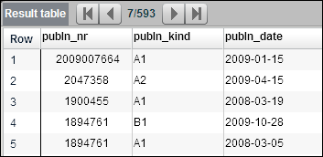
Publications
Publications are all in table tls211_pat_publ. In many case you would combine the publication with application data. Because every publication belongs to an application, a (INNER) JOIN is sufficient.
SELECT publn_nr, publn_kind, publn_date
FROM tls211_pat_publn p
JOIN tls201_appln a ON p.appln_id = a.appln_id
WHERE appln_filing_date = '2007-07-07' -- for example
Notes:
Note that every publication belongs to exactly one application; if there is a publication but no application in the original data, we have introduced an artificial application in order to have a consistent database.
Similarly, every non-artificial application has one or more publications. There are, however, artificial applications which do not have a publication - no wonder, because we do not have any data about these artificial applications, which probably do not exist at all, so their publications are even less certain and therefore not relevant..

Slide 88
Citations to patent publications (1)
Publications may contain citations (tls212_citation). Citations can refer to other publications, NPL or applications.
This query retrieves citations of patent publications only.
SELECT c.citn_origin, c.pat_citn_seq_nr , p2.publn_auth, p2.publn_nr, p2.publn_kind
FROM tls211_pat_publn p1
LEFT JOIN tls212_citation c ON p1.pat_publn_id = c.pat_publn_id
JOIN tls211_pat_publn p2 ON c.cited_pat_publn_id = p2.pat_publn_id -- citations
WHERE c.pat_citn_seq_nr > 0 -- retrieve only citations to publications
AND p1.publn_auth = 'EP' -- for example
AND p1.publn_nr = '1674117'
AND p1.publn_kind = 'A1'
ORDER BY citn_origin
Notes:
Note: NPL stands for non-patent literature, e.g. books, magazine articles, research papers, web pages, ...
The query retrieves the citations of patent publications of the publication EP 1674117 A1.
The clause "WHERE c.pat_citn_seq_nr > 0" avoids getting dummy rows for all citations which are not citations of patent publications, e.g. citations of NPL or applications.
For the result of this query, see next page.
Cited publications: This is implemented by a reference from the citation table back to the publication table tls211_pat_publn we have already discussed.
Cited NPL (non-patent literature): This is discussed on one of the next slides.
Cited applications: Applicants may cite applications (and not only publications) in the description of their application, because the cited applications may not yet have been published. Currently there are relatively few (Oct. 2012 edition: 75 000) citations of applications, of which 32 000 are artificial applications (possibly they have not yet been published, or there are typos or other errors), so we will not discuss them further.

Slide 89
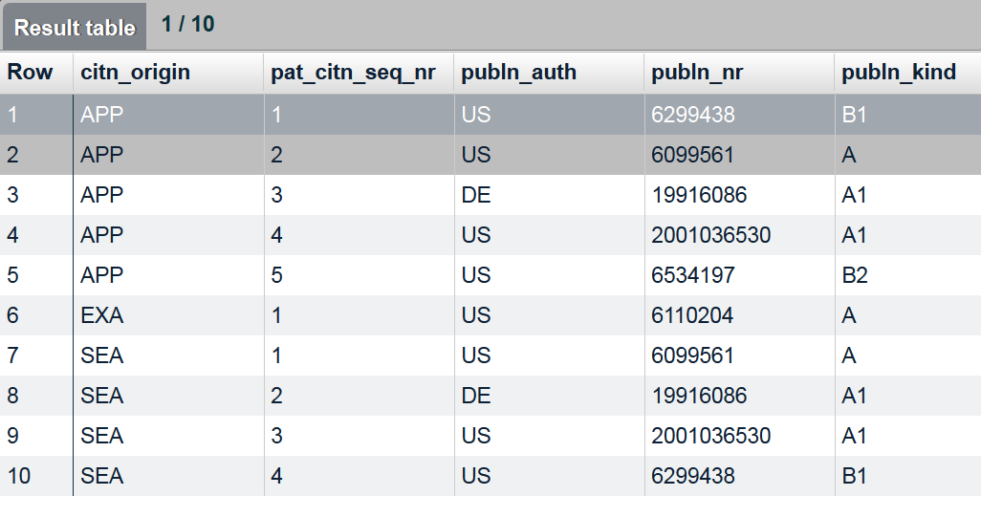
Citations of patent publications (2)
One publication may cite several other publications
One cited publication may be cited several times by different publications
Notes:
The columns retrieved in the previous query are:
The attribute citn_origin deserves a further look. It indicates whether the publication was cited by the applicant, during search, during examination, during opposition, etc.. For details see the PATSTAT Data Catalog.
The sequence of the citation: 1 .. n, within the citn_origin
The next three attributes identify the cited documents

Slide 90
Non-patent literature (NPL)
This query retrieves cited NPL.
SELECT c.citn_origin, c.npl_citn_seq_nr , n.npl_biblio
FROM tls211_pat_publn p1
LEFT JOIN tls212_citation c ON p1.pat_publn_id = c.pat_publn_id
JOIN tls214_npl_publn n ON c.npl_publn_id = n.npl_publn_id -- citations
WHERE c.npl_citn_seq_nr > 0 -- retrieve only citations to NPL
AND p1.publn_auth = 'EP' -- for example
AND p1.publn_nr = '1674117'
AND p1.publn_kind = 'A1'
ORDER BY citn_origin
Notes:
Currently, the non-patent literature is just a long unstructured string. The EPO is working on providing more structured NPL data in DOCDB. Once this is finished, the data will also be made available in PATSTAT.
This query retrieves the non-patent literature cited in the same publication (EP 1674117 A1) as before.
We can now join the citation table to the table tls214_npl_publn instead of tls211_pat_publn. Also as before, we can apply "WHERE c.npl_citn_seq_nr > 0" to restrict the result to NPL.
The analysed publication has a single NPL citation.

Slide 91
Citation categories (1)
All citations may be categorised (X, Y, A, D, ...) and have 0, 1 or more rows in table tls215_citn_categ.
This query retrieves all categories of all citations of a certain publication.
SELECT c.citn_id, c.pat_citn_seq_nr, c.npl_citn_seq_nr, c.citn_origin, ccat.citn_categ
FROM tls211_pat_publn p
JOIN tls212_citation c ON p.pat_publn_id = c.pat_publn_id
LEFT JOIN tls215_citn_categ ccat ON c.pat_publn_id = ccat.pat_publn_id
AND c.citn_id = ccat.citn_id -- category of citations
WHERE p.publn_auth = 'EP' -- for example
AND p.publn_nr = '1674117'
AND p.publn_kind = 'A1'
ORDER BY c.citn_id
Notes:
To join the citation table and the citation category table, you have to match two attributes: the publication ID of the citing application and the sequence number of the citation:
LEFT OUTER JOIN tls215_citn_categ ccat ON c.pat_publn_id = ccat.pat_publn_id AND c.citn_id = ccat.citn_id
Here, we are not interested in the details of the cited documents (patent publications, NPL or applications), so we do not include them in this query.
For the result of this query, see the next slide.

Slide 92
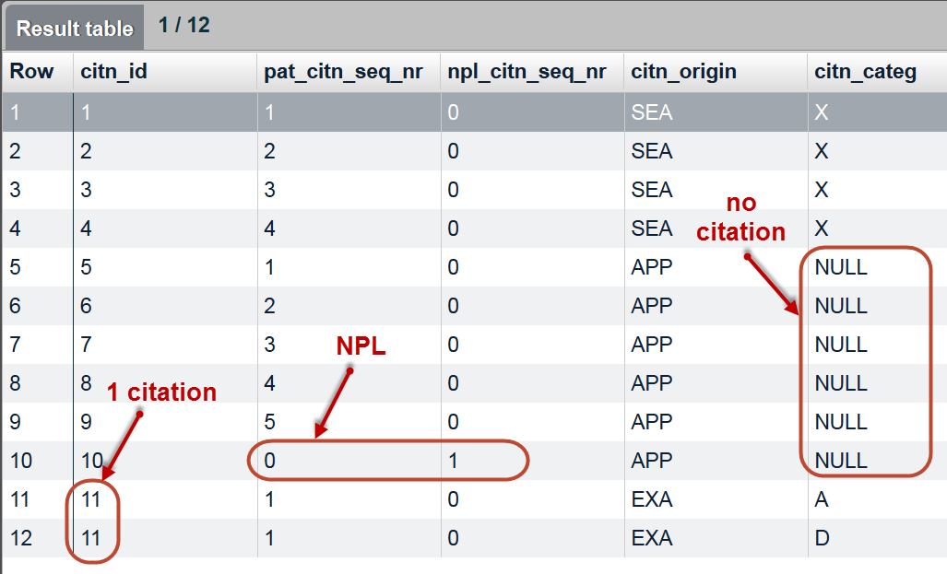
Citation categories (2)
The query retrieved:
Notes:
The columns retrieved in the previous query are:
citn_id is a sequence number 1..n for citations. We see that rows 11 and 12 have the same citn_id, and therefore refer to the same citation, which is in two citation categories (A and D)
There are two columns separately numbering the patent publication citations and the NPL citations. within the citn_origin. We can see that there are ten patent publication citations and (in row 10) one NPL citation.
The attribute citn_origin deserves a further look. It indicates whether the citation was done by the applicant, during search, during examination, during opposition, etc. For details, see the PATSTAT Data Catalog. E.g. citn_origin = APP means that the citation was introduced by the applicant, which explains why there is no citation category.
The last column contains zero or one citation category. The categories are explained in WIPO Standard ST.14 (http://www.wipo.int/standards/en/pdf/03-14-01.pdf) and the EPO Guidelines for Examination (http://www.epo.org/law-practice/legal-texts/html/guidelines/e/b_x_9_2.htm). In rows 11 and 12, the patent publication citation has been assigned two categories: A and D.

Slide 93
Tips for writing queries

Slide 94
1. Clarify the information needed
Write down what information you need
Choose the right aggregation level: Are you interested in families, applications, publications or any other "units"?
What filter conditions have to be applied to limit the data?
What information should the output contain?
Identify the tables and attributes you need in your query to create the output or define the conditions
Consult the Data Catalog on the meaning of tables and content
Choose the appropriate date for your analysis: priority date, filing date, publication date, date of grant ...
Choose the right classification, family, IP right, etc.

Slide 95
2. Check coverage and quality
Is the information needed available in PATSTAT (e.g. the publications of a certain country and period)?
See http://www.epo.org/searching-for-patents/helpful-resources/raw-data/data/tables/weekly.html and https://public.tableau.com/profile/patstat.support#!/vizhome/CoverageofPATSTAT2018AutumnEdition/CoveragePATSTATGlobal
Run test queries to check the actual data content
Use TOP clause to limit the output to a sensible amount
Use GROUP BY to count the number of rows of certain countries, types, kind codes, number ranges, time periods, etc.
Is the outcome as expected? If not, consult the Data Catalog and re-check.

Slide 96
3. Query formulation
Start with a simple query and incrementally extend it with more JOINs and conditions as required.
Between steps: verify that you are actually retrieving the data you want. You can check applications in detail:
In Espacenet by searching with APPLN_NR_EPODOC or PUBLN_AUTH & PUBLN_NR
In PATSTAT Online, in the Result window
Repeat the cycle: Run – Check – Enhance query – Run – ....
When using a locally installed PATSTAT database, avoid complex queries. Create intermediate tables and check.

Slide 97
4. Empower your queries
Avoid using repetitive queries where only the year, the office, the classification, etc. is manually changed. Use the power of SQL to get your results in a single query, using e.g.
the IN operator to compare a list of values
the OR operator, e.g. with a LIKE operator and wildcards
the GROUP BY when counting rows grouped by some criteria
Subqueries or the EXISTS operator are often useful too

Slide 98
5. Improve performance
Speed up your query when execution time is too long.
If you use your own database: Make sure you have defined indexes for attributes used in JOIN and WHERE clauses. Overindexing decreases query time and does no harm if you do not change the source data. In addition, you can precompute and store values which you require frequently and which are costly to compute on the fly.
In PATSTAT Online all sensible indexes have already been defined. If still necessary, you can have a look at the costs shown in the Estimated Query Plan to finetune your query: Press <Ctrl><lower case L> in the query editor and check the result table.

Slide 99
6. Downloading and post-processing
PATSTAT Online allows you to retrieve large sets of data. This is ideally for further "offline" analysis or visualisation in your own favourite tools. See the PATSTAT Online user manual for details.
Download the result table, as returned by your query
Download a consistent database (e.g. in MS Access format), as defined by your query with the Subset Download feature.

Slide 100
Wrap-up

Slide 101
General structure of SELECT
SELECT [DISTINCT] [TOP n] col1, col2, col 3 ... ¦ *
FROM table1
JOIN table2 ON join condition(s) -- JOIN clause may repeat
WHERE col3 = 1 -- filter condition(s)
AND col4 = ‘Text’ -- filter condition(s)
GROUP BY col1, col2 -- aggregation attribute(s)
HAVING count(*) > 1
ORDER BY col1 -- sort attribute(s)
Notes:
This is an overview of the clauses we have covered in this paper. Note that the order of the clauses must not be changed.
[Square brackets] enclose optional parts.

Slide 102
Resources
PATSTAT resources for download (Data Catalog, sample queries, tips, etc.)
In PATSTAT Online, go to the menu Help > Database help or
Go directly to the Download section under the Documentation tab at http://www.epo.org/searching-for-patents/business/patstat.html
User support :
questions on PATSTAT access, subscription or prices
other PATSTAT-related questions

