Slide 1
Past, present and future of
CAR T-cell technology
Authors
Corresponding Author
Björn Jürgens (CITPIA Patlib Centre)
Support on search strategy
Fredrik Aslund (EPO)
Peter Bumb (EPO)
Dominique Manu (EPO)
Project coordination
Nigel Clarke (EPO)
The research was completed
in December 2017
Evolution of CAR T-cell immunotherapy in terms of
patenting activity
Björn Jürgens (CITIPIA Patlib Centre)
Nigel Clarke EPO Vienna
14 February 2018
Notes:
RF

Slide 2
What is patent information?
Patents cover technical inventions, patent publications are a natural source of data regarding technical change.
Especially in emerging and research intensive sectors, patent information offers a basis for analysis where other data is scarce.

Slide 3
What is patent information?
The analysis of patent information has several advantages:
Patents are a rich source of information and are closely linked to inventions and innovation
Patents are available as long time series and across many countries
Patents are available free of cost from patent search platforms like Espacenet

Slide 4
How can we use patent information to analyse a technological field?
Taking advantage of its structured format, patent statistics are conducted on a large set of bibliographic patent references with bibliometric techniques.
The most commonly used ones are single field and cross-reference analysis.
Single field analysis of a bibliographic patent field generates a list or a ranking whereas the cross-reference analysis combines two fields and generates a matrix that can reveal valuable information for a technology watch activity:

Slide 5
How can we use patent information to analyse a technological field?
 | Applicants | Inventors | Publication Year | Priority Country | Classes
Applicants | Collaboration between organisations | Where are the researchers working | Evolution of filing activity | Home market or most important market | Key technological areas of applicants
Inventors |  | Collaboration between researchers / inventors | Evolution of inventors patenting activity | Inventors country of origin | Research fields of the inventors
Publication Year |  |  | Evolution of the activity per country | Evolution of country patent output | Evolution of technology sector
Priority Country |  |  |  | Collaboration between countries | Key technological areas of countries
Classes |  |  |  |  | Relationships between technological domains

Slide 6
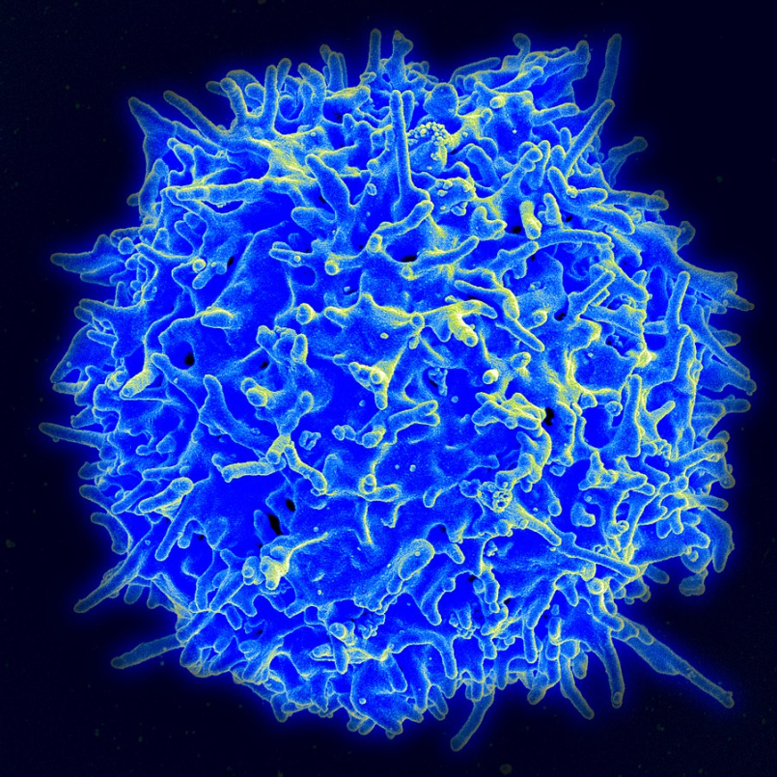
What are CAR T-cells?
CAR = Chimeric Antigen Receptor
A T cell, or T lymphocyte, is a type of lymphocyte (a subtype of white blood cell) that plays a central role in cell-mediated immunity.

Slide 7
What is CAR T-cell immunotherapy?
Over the past several years new cancer therapies have been developed that strengthen the power of a patient’s immune system to attack tumours – cancer immunotherapy. One of the most promising techniques is CAR T-cell therapy.
CAR T-cell therapy works by getting the T-cells to fight cancer by genetically re-programming them in the laboratory to produce chimeric antigen receptors (CARs) on their surface which are proteins that allow the T-cells to specifically find and destroy cancer cells.

Slide 8
What is CAR T-cell immunotherapy?
CAR T-cell therapy captured the attention of the public because of the remarkable responses it has produced in some patients for whom all other treatments had stopped working.
That is why research has been intensified in this field over the last few years, making it a highly interesting field of study for a patent analysis in order to get insight into the developments of this innovative technology ...

Slide 9

What is CAR T-cell immunotherapy?
T-Cells are extracted from a blood sample
1
T-Cells are genetically re-programmed to produce CAR and then administered back to patient
2
Modified T-Cells recognise and kill the tumour
3

Slide 10
Method – Classification and keyword

Slide 11
Method - Search queries
GPI
(CLAS=C07K2319/03 AND (CLAS=C07K2317/622 OR CLAS=C07K2317/55)) OR ((WORD="CAR-T" OR WORD="chimeric antigen receptor") AND (CLAS=C07K14/705 OR CLAS=A61K35/17))
MATHEO PATENT (Espacenet)
CPC:(C07K2319/03 AND (C07K2317/622 OR C07K2317/55))
TA:("CAR-T" OR "chimeric antigen receptor") AND (IPC:C07K14/705 OR IPC:A61K35/17)
LENS
((title:("CAR-T" OR "chimeric antigen receptor") || abstract:("CAR-T" OR "chimeric antigen receptor") || claims:("CAR-T" OR "chimeric antigen receptor")) && classification_ipcr:(C07K14\/705 OR A61K35\/17)) || classification_cpc:(C07K2319\/03 AND (C07K2317\/622 OR C07K2317\/55))

Slide 12
Search tools
The GPI meta field identifier CLAS was used in both IPC and CPC searches since it searches in all available classifications e.g. it was used in order to include in the search also patents classified with CPC from national offices (invention and additional information).
For the keyword search the GPI field identifier WORD was used since it searches in both Title and Abstract fields in all languages.
Third party tools were used for specific tasks:
Matheo Patent was used for data harmonisation of the data set and the generation of network node maps.
Lens was used for the Tag map generation.

Slide 13

Where do CAR T-cell applicants come from?
Other 11%
France 3%
Japan 4%
Germany 5%
39% USA
United Kingdom 5%
China 33%
Most CAR-T patent applicants have their headquarters in the US and China, followed by the UK, Germany, Japan and France.

Slide 14
CAR T-cell patenting evolution
CAR-T patenting took off from 2013 with a significant increase in published patent filings in multiple countries (patent documents), but also the publication of CAR-T related inventions (patent families) from 61 in 2014 to 285 inventions in 2017.

Slide 15
Type of CAR T-cell applicants
Research Centre
40%
Industry
49%
Individual 11%
Nearly half of all CAR-T related patents are filed by industry, followed by research centres, most of them universities, research institutes and hospitals. Some patents are filed by individuals which in most cases are affiliated researchers but have 100% ownership of the patent.

Slide 16
Top 20 CAR T-cell inventors
Rank | Inventor | Inventions (# patent families) | Patents (# filed)
1 | June Carl (US) | 31 | 315
2 | Milone Michael (US) | 19 | 168
3 | Pule Martin (GB) | 17 | 119
4 | Brogdon Jennifer (US) | 14 | 118
5 | Loew Andreas (US) | 12 | 92
6 | Luo Ruixue (CN) | 12 | 15
7 | Zhao Yangbing (US) | 11 | 91
8 | Cordoba Shaun-paul (GB) | 11 | 71
9 | Wu Qilong (US) | 10 | 76
10 | Mannick Joan (US) | 10 | 74
Rank | Inventor | Inventions (# patent families) | Patents (# filed)
1 | Murphy Leon (US) | 10 | 74
2 | Powell Daniel (US) | 10 | 56
3 | Galetto Roman (FR) | 9 | 85
4 | Glass David (US) | 9 | 70
5 | John Scholler (US) | 8 | 81
6 | Duchateau Philippe (FR) | 8 | 56
7 | Qi Wei (CN) | 8 | 8
8 | Yu Lei (CN) | 8 | 8
9 | Gill Saar (US) | 7 | 61
10 | Forman Stephen (US) | 7 | 45
The most productive CAR-T inventor is the American researcher Carl June. He is one of the CAR-T pioneers working at the University of Pennsylvania.

Slide 17
Top 20 CAR T applicants (industry)
Rank | Applicant | Inventions (# patent families) | Patents (# filed)
1 | Novartis AG (CH) | 29 | 178
2 | Cellectis SA (FR) | 21 | 165
3 | Suzhou Puluoda Biological Science and Tech Co. Ltd. (CN) | 12 | 15
4 | Bluebird Bio Inc. (US) | 9 | 31
5 | Eureka Therapeutics Inc. (US) | 7 | 27
6 | Sinobioway Bioeconomy Group Co. Ltd. (CN) | 7 | 7
7 | Shanghai Youkadi Biological Pharmaceutical Tech Co. Ltd. (CN) | 6 | 6
8 | Carsgen Therapeutics Ltd. (CN) | 5 | 21
9 | Beijing Marino Biotechnology Co. Ltd. (CN) | 5 | 10
10 | Autolus Ltd. (GB) | 4 | 13
11 | Shanghai Unicar-therapy Bio-medicine Tech Co. Ltd. (CN) | 4 | 4
12 | Celgene Corp. (US) | 3 | 34
13 | Pfizer Inc. (US) | 3 | 18
14 | Miltenyi Biotec GmbH (DE) | 3 | 11
15 | Juno Therapeutics Inc. (US) | 3 | 9
16 | Cellular Biomedicine Group Ltd. (CN) | 3 | 6
17 | Kite Pharma Inc. (US) | 3 | 6
18 | Beijing Immunochina Medical Science & Tech Co. Ltd. (CN) | 3 | 4
19 | Apceth GmbH & Co. KG (DE) | 2 | 9
20 | Aleta Biotherapeutics Inc. (US) | 2 | 2

Slide 18
Who is patenting when?
Univ Pennsylvania (US)
Baylor College of Medicine (US)
Cellectis SA (FR)
Bluebird Bio Inc. (US)
Univ College London (GB)
Univ Texas (US)
Suzhou Puluoda Biological Science and Tech Co. Ltd. (CN)
Eureka Therapeutics Inc. (US)
National Cancer Institute (US Health Dep.) (US)
Novartis AG (CH)

Slide 19
Top 20 CAR-T applicants (Research Centres)
Rank | Applicant | Inventions (# patent families) | Patents (# filed)
1 | Univ Pennsylvania (US) | 54 | 428
2 | Univ College London (GB) | 15 | 117
3 | National Cancer Institute (US Health Dep) (US) | 14 | 98
4 | Memorial Sloan-Kettering Cancer Center (US) | 11 | 80
5 | City Of Hope Research Center (US) | 8 | 59
6 | Univ Texas (US) | 8 | 56
7 | Baylor College of Medicine (US) | 8 | 40
8 | Seattle Childrens Hospital (US) | 6 | 90
9 | Fred Hutchinson Cancer Research Center (US) | 6 | 40
10 | Chinese Pla General Hospital (CN) | 5 | 10
11 | Univ California (US) | 4 | 32
12 | Dana-Farber Cancer Institute (US) | 4 | 17
13 | Univ Köln (DE) | 3 | 10
14 | Univ Washington (US) | 3 | 10
15 | Univ Southern California (US) | 3 | 4
16 | Univ Nagoya (JP) | 3 | 3
17 | Univ North Carolina (US) | 3 | 3
18 | Roger Williams Medical Center (US) | 2 | 16
19 | Ohio State Innovation Foundation (US) | 2 | 14
20 | Forschungsinstitut Georg-Speyer-Haus (DE) | 2 | 14

Slide 20
CAR T-cell patents with most family members
Univ Pennsylvania (US)
Univ Washington & Seattle Childrens Hospital (US)
Univ College
London (GB)
Cellectis
Memorial Sloan-
Kettering (US)
Top 5 patents with most family members, that means more than one application for the same invention filed with different patent authorities. This is an important indicator for the value of the patent since the applicant is willing to absorb the correspondent high costs of patenting in multiple countries.

Slide 21

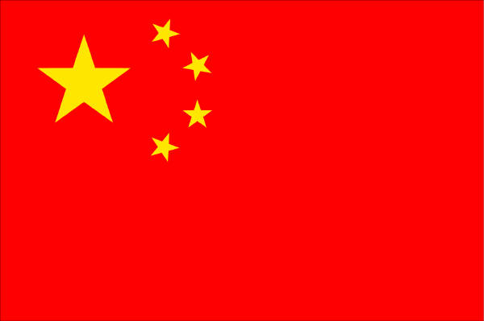

CAR T-cell patents with most inventors
Patent title and applicant | # of inventors and their country of residence
Cd20 therapies, cd22 therapies, and combination therapies with a cd19 chimeric antigen receptor expressing cell (Novartis & Univ Pennsylvania)
Treatment of cancer using anti-cd19 chimeric antigen receptor (Novartis & Univ Pennsylvania)
Phosphoglycerate kinase promoters and methods of use for expressing chimeric antigen receptor (Novartis & Novartis China & Univ Pennsylvania)
Regulatable chimeric antigen receptor (Novartis & Univ Pennsylvania)
Treatment of cancer using a cll-1 chimeric antigen receptor (Novartis & Univ Pennsylvania)
Top 5 patents with most inventors in co-authorship, most of them working in the USA and all of these are filed in co-ownership of the Swiss pharmaceutical Novartis and the American University of Pennsylvania.

Slide 22




CAR T-cell patents with most applicants
Patent title and number (family representative) | # of inventors and their country of residence
Lentiviral vectors for regulated expression of a chimeric antigen receptor molecule (WO2016012623)
Claudin-6-specific immunoreceptors and t cell epitopes (WO2015150327)
Kappa myeloma antigen chimeric antigen receptors and uses thereof (WO2016172703)
Anti-ror1 chimeric antigen receptors (WO2016187216)
Chimeric antigen receptor (WO2017158337)
Top 5 patents with most applicants in co-ownership, all of these originate from the same country
(no international collaboration detected)

Slide 23
Top cited CAR T-cell patents
Univ Pennsylvania (US)
Use of chimeric antigen receptor-modified T cells to treat cancer (WO2012079000)
101 citations received
Fred Hutchinson Cancer Research Center &
Seattle Childrens Hospital (US)
Method and compositions for cellular immunotherapy (WO2014031687)
39 citations
received
Dartmouth College
T cell receptor-deficient T cell compositions (WO2011059836)
36 citations
received
Novartis & Univ Pennsylvania
Treatment of cancer using humanized anti-cd19 chimeric antigen receptor (WO2014153270)
29 citations
received
Novartis & Univ Pennsylvania
Treatment of cancer using chimeric antigen receptor (WO2015142675)
27 citations
received
Citing Doc. #
The patent from the University of Pennsylvania is not only the one with most family extensions but also the most cited, followed by a patent that is in co-ownership from the Fred Hutchinson Research Centre and the Seattle Children's Hospital (both US).

Slide 24
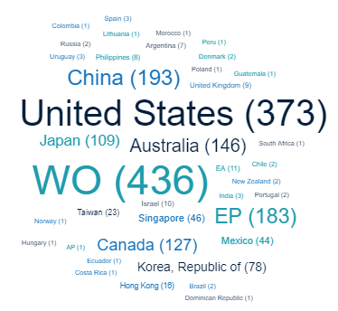
Important CAR T-cell markets:
where are CAR T-cell patents filed?
Regarding the patent jurisdictions most CAR-T patents are PCT filings (WO) , followed by filings in the USA, China, Europe (EP patents) and Australia. Word cloud courtesy Lens https://www.lens.org/lens/

Slide 25
Most productive countries
27 (GB)
22 (FR)
3
32 (CH)
209
15 (DE)
101
1
2
Applicants from the USA are the most productive (209 CAR-T patent families), followed by Chinese applicants and Swiss (mainly Novartis), British, French and German applicants.

Slide 26
Who co-operates with whom?
Seattle Childrens Hospital
6
1
4
1
3
1
6
Univ California (US)
Univ Washington (US)
Fred Hutchinson Cancer Research Center (US)
Novartis AG (CH)
29
29
54
Univ Pennsylvania (US)
1
14
National Cancer Institute (US Health Dep) (US)
Aleta Biotherapeutics Inc (US)
2
1
1
Memorial Sloan-Kettering Cancer Center (US)
11
5
Cellectis SA (FR)
21
5
Eureka Therapeutics Inc (US)
7
Pfizer Inc (US)
3
1
2
Rinat Neuroscience Corp (US)
2
Bluebird Bio Inc (US)
9
1
Biontech Cell & Gene Therapies GmbH (DE)
2
Univ Nagoya (JP)
3
Univ Mainz (DE)
2
2
2
Univ Shinshu (JP)
3
Shanghai Cell Therapy Inst (CN)
2
Cancer Research Technology Ltd (GB)
2
2
Dongfang Hospital Military Medical University (CN)
2
2
Univ Birmingham (GB)
2
Network node maps that visualise the co-ownership of patents can give us insights about collaborations between companies and/or research centres and possible licensing of inventions. In the CAR-T case we see a strong partnership between the University of Pennsylvania and Novartis with 29 inventions in co-ownership. Another remarkable cooperation is between the US company Eureka and the Memorial Sloan-Kettering Center with 5 common inventions. Taking into account the number of different cooperation partners the Seattle Hospital is the only one which has patent co-ownership with 3 other different centres.

