Slide 1
Quantum sensing and metrology
Patent Landscaping Study
Overview of the evolution of second generation quantum applications

Slide 2
Contents
The EPO and its Mission Statement
Patent Information
Quantum Technology
Quantum Sensing & Metrology
Patent Landscaping Study
Acknowledgements
Contact Us
Notes:
2

Slide 3
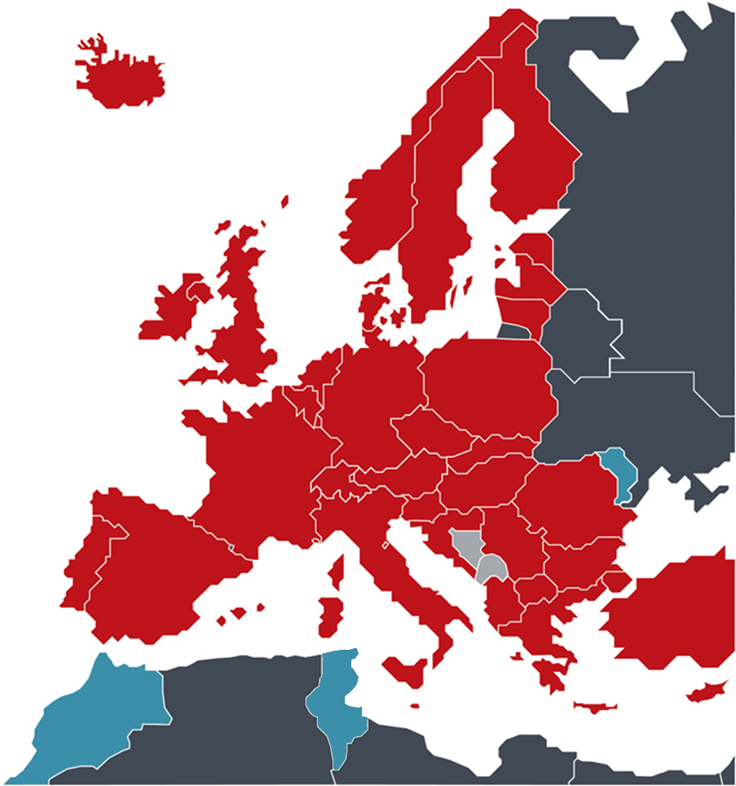
Today ... an area with some
700m inhabitants
38 European member states
Belgium • Germany • France • Luxembourg
Netherlands • Switzerland • United Kingdom Sweden • Italy • Austria • Liechtenstein • Greece Spain • Denmark • Monaco • Portugal • Ireland Finland • Cyprus • Turkey • Bulgaria • Czech Rep. Estonia • Slovakia • Slovenia • Hungary • Romania Poland • Iceland • Lithuania • Latvia • Malta
Croatia • Norway • Former Yugoslav Rep. Macedonia • San Marino • Albania • Serbia
Two European extension states
Bosnia-Herzegovina • Montenegro
Three validation states
Republic of Moldova • Morocco
Tunisia

Slide 4
EPO‘s Mission Statement
“As the Patent Office for Europe, we support innovation, competitiveness and economic growth across Europe
through a commitment to high quality and efficient services delivered under the EPC”
Contribution to EU GDP
Contribution to EU trade
IPR-intensive industries,
€ 5.7 trillion, 42%
Patent-intensive industries,
€ 2.0 trillion, 15%
Share of
EU imports
Share of
EU exports
Patent-intensive industries
IPR-intensive industries
Source: IPR-intensive industries and economic performance in the European Union – Joint Report 2016 from the EPO and EUPIO – Data 2011-2013.
Note: IPR: IP rights: trade marks, patents, designs, copyrights, geographical indications and plant variety rights.
Notes:
The EPO Chief Economist unit aims to provide high-level expertise and analysis and to foster well-informed policy debate on issues relating to patents, innovation and economic growth. It develops projects to help the EPO to monitor and understand better how
IPRs are contributing to economic growth and competitiveness!
The EU is an economy built on intellectual property rights
Intellectual property rights, especially patents, are drivers of economic growth and employment in the EU;
IPR-intensive industries are responsible for some 38% of employment in the EU (2011 to 2013)
Between 2011 and 2013, patent-intensive industries alone contributed 2 trillion Euros to the EU's GDP. patents are used and what their economic impact is.

Slide 5
Contents
EPO’s Mission Statement
Patent Information
Quantum Technology
Quantum Sensing & Metrology
Patent Landscaping Study
Future Plans
Acknowledgements
Contact Us
Notes:
5

Slide 6
Patent Information
Use Patent information as an important source of technical, legal and business-related information
Use (free) patent databases to retrieve strategic information
  consult them before and during research, development and commercialisation
Use Espacenet and other free sources to identify
  existing technologies
  gaps in technology
  key players
  potential infringement and trends

Slide 7
Patent Information – helping innovation
Technical
information
Avoid duplication
Identify existing technology and build on it
Legal
information
Check freedom to operate
Avoid infringement of patent rights
Monitor competitors
Identify new partners
Detect new market and technology trends
Business
information
Notes:
The three key types of information coming from patent data (technical, legal and business) are elaborated in greater detail in the following three slides, so no need to stay long on this one.

Slide 8
A fair system driving knowledge transfer & innovation
Find existing
technology
Patent
application
Technological
innovation
Learn from it
New invention
Disclosure
to the public
Legal
protection
Build on it
Patent information
Notes:
The “patent deal” not only guarantees a fair balance between patent owners and society, but also fosters innovation in general. While patents provide their owners with protection, patent documents contain information that can be vital to any number of people, from technical developers and researchers to legal advisers and business strategy managers.
Patent information can be helpful in so many ways. For example, you can use it to find out what already exists, in order to build on it. If you are faced with a technical problem, there is no better way of finding out what solutions are already available than by looking at patents.
You can also use it to keep track of who is doing what. Technical details of research being carried out by your competitors may well appear first in a patent document, long before the product reaches the marketplace. By monitoring patent documents, you can keep an eye on your business competitors, and even locate potential partners.
Patent information can also be used to identify patents that are no longer in force and are therefore free to use. And by “watching” or monitoring patent publications, you can spot trends in technology or the market at an early stage.
Last but by no means least, before you launch a new product or service, you need to make sure that you will not be infringing someone else's patent. Patent information will help you here, too.

Slide 9
Contents
EPO’s Mission Statement
Patent Information
Quantum Technology
Quantum Sensing & Metrology
Patent Landscaping Study
Future Plans
Acknowledgements
Contact Us
Notes:
9

Slide 10
Quantum Technology
2nd quantum generation technology has been around ~20 years;
In the field of physics and engineering;
Manipulating physical systems at quantum level, exploring properties such as:
  Entanglement;
  Superposition;
Emerging in various sectors;
To be responsible for most key physical technological advances in this century.
Notes:
Information from:
- QT Flagship Final Report
QT: Implications for European Policy (JRC)
- “Quantum technology: the second quantum revolution” – Jonathan Dowling and Gerard J. Milburn

Slide 11
Quantum Technology
Quantum communication
Quantum computation
Quantum simulation
Quantum sensing & metrology
Leading domains
of QT

Slide 12
Contents
EPO’s Mission Statement
Patent Information
Quantum Technology
Quantum Sensing & Metrology
Patent Landscaping Study
Future Plans
Acknowledgements
Contact Us
Notes:
12

Slide 13
Quantum Sensing & Metrology
Five sub-sections:
Gravitation, rotation and acceleration
Time
Magnetic fields
Chemical detection
Imaging

Slide 14
What is patent information?
About Quantum sensing and metrology
As patents cover mainly technical inventions, they are a natural source of data regarding technical change. Especially in emerging and research intensive sectors, patent information offers a basis for analysis where other data is scarce.
The analysis of patent information has several advantages:
Patents are a rich source of information and are closely linked to inventions and innovations
Patents are available as long time series and across many countries
Patents are available free of cost from patent search platforms like Espacenet (www.espacenet.com )
Within the last two decades, we are experiencing a second quantum revolution with tremendous progress, moving into a cross-disciplinary field of applied research where technologies are being developed now that explicitly address individual quantum states and make use of the quantum properties, such as superposition and entanglement. One of the important fields of the second generation quantum technologies is related to sensing and metrology and can be divided into the following fields of applications:
Gravitation, rotation and acceleration
Atomic and molecular interferometer devices use superposition to measure gravitation, acceleration and rotation very precisely. These signals can be processed e.g. to enable inertial navigation devices to navigate below ground or within buildings.
How can we use patent information
to analyse a technological field?
Time
Quantum metrology employs intrinsically quantum
mechanical features that can be used to perform
precise measurements of time. New optical atomic
clocks i.e. using visible wavelengths, are surpassing
in precision the current first generation atomic clocks.
Magnetic fields
Solid-state quantum sensors, such as nitrogen
vacancy centres in diamond, have been shown to be
useful for measuring very small magnetic fields. This
may help with multiple applications, from biosensors
to magnetic resonance imaging and detection of
defects in metals.
Taking advantage of its structured format, patent statistics are conducted on
a large set of bibliographic patent references with bibliometric techniques.
The most commonly used ones are single field and cross-reference analysis.
Single field analysis of a bibliographic patent field generates a list or a ranking whereas the cross-reference analysis combines two fields and generates a
matrix that can reveal valuable information for a technology watch activity:
 | Applicants | Inventors | Publication Year | Priority Country | Classes
Applicants | Collaboration between organisations | Where are the researchers working | Evolution of filing activity | Home market or most important market | Key technological areas of applicants
Inventors |  | Collaboration between research-ers / inventors | Evolution of inventors patenting activity | Inventors country of origin | Research fields of the inventors
Publication Year |  |  | Evolution of the activity per country | Evolution of country patent output | Evolution of technology sector
Priority Country |  |  |  | Collaboration between countries | Key technological areas of countries
Classes |  |  |  |  | Relationships between techno-logical domains
Optical atomic clock uses two magnetic coils (red rings) and an optical lattice (red laser beam)¹
Chemical detection
Several chemical detection techniques exploit quantum effects in nanoscale semiconductor structures. They potentially offer a useful tool for law-enforcement (e.g. in detection of explosives and narcotics) and they can be customized to be sensitive to biochemicals (with potential applications in medicine).
Imaging
Quantum imaging devices use entangled light to extract more information from light during imaging. This can greatly improve imaging technologies by, for example, allowing higher resolution images or creating the ability to produce an image by measuring one single photon which is entangled with a second.
Definitions from: Quantum Technologies: Implications for European Policy (JRC 2016)
and European Quantum Technologies Roadmap (EU 2017) 1. Image from: NIST, Wikimedia Commons

Slide 15
Using Patent Information to analyse a technical field
 | Applicants | Inventors | Publication Year | Priority Country | Classes
Applicants | Collaboration between organisations | Where are the researchers working | Evolution of filing activity | Home market or most important market | Key technological areas of applicants
Inventors |  | Collaboration between researchers / inventors | Evolution of inventors patenting activity | Inventors country of origin | Research fields of the inventors
Publication Year |  |  | Evolution of the activity per country | Evolution of country patent output | Evolution of technology sector
Priority Country |  |  |  | Collaboration between countries | Key technological areas of countries
Classes |  |  |  |  | Relationships between techno-logical domains

Slide 16
Disclaimer – please note
Analysis carried out until 15th October;
Published patents only;
Data publically available in patent databases (e.g. Espacenet);
Some commercial tools used;
Classification limitations (CPC and IPC);
Cut off date for “allowable” patent publications;
Definition of 2nd generation quantum technology not simple!

Slide 17
Contents
EPO’s Mission Statement
Patent Information
Quantum Technology
Quantum Sensing & Metrology
Patent Landscaping Study
Future Plans
Acknowledgements
Contact Us
Notes:
17

Slide 18
Patent Landscaping Study
Experts identified second generation quantum application in sensing & metrology;
Search queries tailored for each of the five sub-sections;
Full-text search;
Queries based at least on:
  Classification schemes;
  Keywords, synonyms;
  Semantics, concepts;
  Dates, priority (filing), publication;
  Authors (inventors and applicants).

Slide 19
Evolution in patent publications (2000-2018)
Notes:
Compared to other emerging technological fields, the number of patent publications in second generation Quantum Sensing & Metrology technologies were not very high in the first decade with roughly 10 inventions a year, due to probably its strong background in basic science. Nevertheless the significant raise over the last 7 years show us that more Quantum Sensing & Metrology technologies are becoming applied technologies that can be patentable.
Reason for 2016 drop in patent publications?

Slide 20

Country patenting evolution (Jurisdiction)
Notes:
When analysing by the geographical region where a patent is protected we can see that, besides China (CN) and the United States (US) many applicants seek protection via the PCT system (WO) and the European Patent (EP).

Slide 21
Top applicants per field
1
2
3
Gravitation, rotation and acceleration
Applicant | Patents¹ | Sector
WUHAN INSTITUTE OF PHYSICS & MATHEMATICS (CN) | 13 | Research - Government
HUAZHONG UNIVERSITY OF SCIENCE & TECHNOLOGY (CN) | 8 | University - Public
OBSERVATOIRE DE PARIS (FR) | 5 | Research - Government
Time
Applicant | Patents¹ | Sector
SEIKO EPSON (JP) | 4 | Private company - Electronics
UNIVERSITY BEIJING (CN) | 3 | University - Public
CSEM - CENTRE SUISSE D ELECTRONIQUE ET DE MICROTECHNIQUE | 2 | Research - Government
Magnetic fields
Applicant | Patents¹ | Sector
LOCKHEED MARTIN (US) | 53 | Private company - Defence
HARVARD (US) | 9 | University - Private
ELEMENT SIX (UK) | 3 | Private company - Optics
Chemical detection
Applicant | Patents¹ | Sector
SHAOGUAN UNIVERSITY (CN) | 7 | University - Public
GUANGXI TEACHERS EDUCATION UNIVERSITY (CN) | 5 | University - Public
JIANGSU UNIVERSITY (CN) | 4 | University - Public
Imaging
Applicant | Patents¹ | Sector
CARL ZEISS (DE) | 8 | Private company - Optics
TOSHIBA (JP) | 4 | Private company - Electronics
UT BATTELLE (US) | 4 | Research - Private
Notes:
1. Patent family count
When analysing the specific fields of Quantum Sening & Metrology and the top players involved, some geographical focal points become evident. The Chinese Wuhan Institute of Physics and Mathematics , and the Huazhong University both have a strong focus to patents related to Gravitation, rotation and acceleration, as also are the two French research organizations (Observatoire and ONRA). The US company Lookheed Martin has built up an extensive patent portfolio related to magnetic fields, whereas it is interesting to see that the field of chemical detection is dominated by Chinese applicants from research and university.

Slide 22
Top applicants from Asia, Europe and America
Region | Applicant | Patents¹ | Sector
Asia | WUHAN INSTITUTE OF PHYSICS & MATHEMATICS (CN) | 14 | Research - Government
Asia | HUAZHONG UNIVERSITY OF SCIENCE & TECHNOLOGY (CN) | 8 | University - Public
Asia | SEIKO EPSON (JP) | 8 | Company - Electronics
Asia | SHAOGUAN UNIVERSITY (CN) | 7 | University - Public
Asia | UNIVERSITY OF SCIENCE & TECHNOLOGY OF CHINA (CN) | 7 | University - Public
Europe | OBSERVATOIRE DE PARIS (FR) | 6 | Research - Government
Europe | CARL ZEISS (DE) | 8 | Company - Optics
Europe | CNRS - CENTRE NATIONAL DE LA RECHERCHE SCIENTIFIQUE (FR) | 6 | Research - Government
Europe | ELEMENT SIX (UK) | 5 | Private company - Optics
Europe | OFFICE NATIONAL D ETUDES & DE RECHERCHES AEROSPATIALES (FR) | 4 | Research - Government
America | LOCKHEED MARTIN (US) | 55 | Company - Defence
America | HARVARD (US) | 11 | University - Private
America | CHARLES STARK DRAPER LABORATORY (US) | 5 | Research - Private
America | HONEYWELL INTERNATIONAL (US) | 4 | Company - Electronics
America | NATIONAL TECHNOLOGY & ENGINEERING SOLUTIONS OF SANDIA (US) | 4 | Research - Government
Notes:
1. Patent family count
When analysing the applicants by their geographical region we see that most applicants of patent applications related to Quantum Sensing & Metrology are coming from Asia (mainly China), Europe (mainly France) and America (mainly USA).

Slide 23
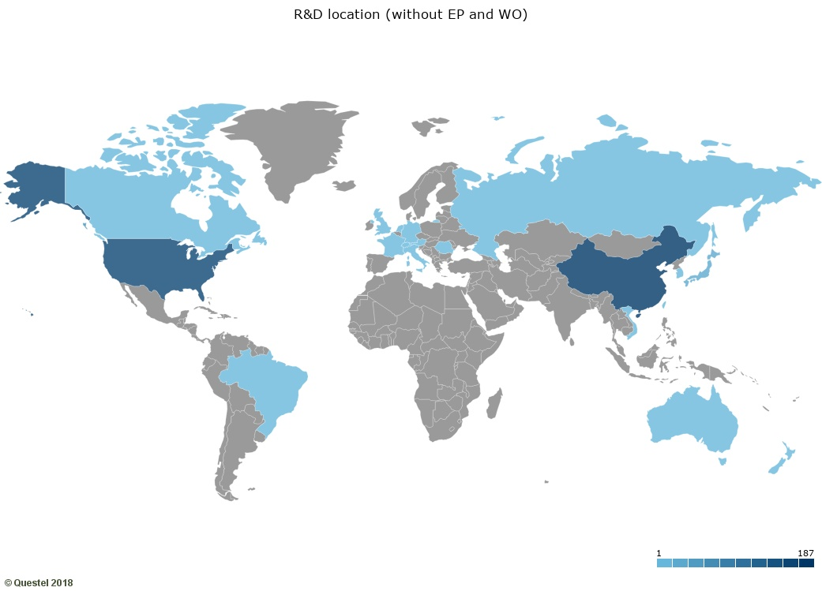
Origin of Quantum sensing & metrology patents
Notes:
Mapamundi with patents published (2000-2018), patent document count by priority country (without EP and WO patents)
The countries where a patent was filed for the first time (the priority patent) are usually the countries where the invention originates and thus can give us information about the geographical origin of inventions. In the case of Quantum Sensing & Metrology we can see that China and USA are the leading countries in numbers of patent publications.

Slide 24
Filing of quantum sensing & metrology patents
Notes:
Patents published (2000-2018), patent document count by publication country
The countries where patent protection is sought are considered as the important markets for a commercialization of the invention.
In the case of Quantum Sensing & Metrology the three most important patent authorities are China (CN), the USA (US) and the European Patent Office (EP).

Slide 25
Top technology evolution heatmap
 | 2010 | 2011 | 2012 | 2013 | 2014 | 2015 | 2016 | 2017
Systems in which the material investigated is excited whereby it emits light, Fluorescence; Phosphorescence (G01N21/64) | 2 | 1 | 3 | 7 | 5 | 11 | 8 | 7
Measuring direction or magnitude of magnetic fields or magnetic flux using magneto-optic devices (G01R33/032) | 0 | 1 | 0 | 0 | 3 | 9 | 10 | 13
Measuring gravitational fields or waves; Gravimetric prospecting or detecting (G01V7/00) | 3 | 0 | 0 | 4 | 4 | 1 | 5 | 1
Interferometers (G01B9/02) | 1 | 2 | 2 | 1 | 0 | 0 | 7 | 3
Gyroscopes; Turn-sensitive devices using vibrating masses (G01C19/58) | 1 | 0 | 1 | 1 | 1 | 2 | 1 | 3
Notes:
Patent families by first priority year
Patents are classified by their technological field, the most important classification schemes being the International Patent Classification (IPC) and the Cooperative Patent Classification (CPC). For our Quantum Sensing & Metrology patent analysis we have identified the top 5 CPC schemes (left) with most patents classified since 2010. It becomes evident that magnetic fields measurement and fluorescence were the top technology patenting trends in the last years for the Quantum Sensing & Metrology patent applicants.

Slide 26
Patent co-authorship
Who is collaboration with whom?
2
4
INSTITUT NATIONAL OPTIQUE CANADA
SAFRAN ELECTRONICS & DEFENSE
2
3
6
2
OBSERVATOIRE DE PARIS
2
2
2
2
3
UNIVERSITE BORDEAUX 1
2
2
3
UNIVERSITE PIERRE & MARIE CURIE
2
6
CNRS – CENTRE NATIONAL DE LA RECHERCE SCIENTIFIQUE
1
2
HORIBA
3
UNIVERSITAET STUTTGART
1
2
5
NICT NATIONAL INSTITUTE OF INFORMATION & COMMUNICATIONS TECHNOLOGY
ELEMENT SIX
1
3
NEC
3
1
HITACHI
11
1
HARVARD
2
JAPAN SCIENCE & TECHNOLOGY AGENCY
Notes:
Collaboration node map of applicants with min. 2 published patents, linked with at least 1 co-assigned patent
Network node maps that visualise the co-ownership of patents can give us insights about collaborations between companies and/or research centres and possible licensing of inventions. For our Quantum sensing and metrology patent landscape a French collaboration cluster becomes evident between several research institutions, universities and a defence company (Safran) and outside France with the Quebec based Canadian National Optics Institute. The three nodes below show a good example of public private partnership in patenting, transnational (left node, with the US university Harvard, the UK company Element Six and the German University of Stuttgart) or national (middle and right) with Japanese companies and research institutes in co-authorship.

Slide 27
Patent citations
Who is influencing whom?
4
NATIONAL TECHNOLOGY & ENGINEERING SOLUTIONS OF SANDIA
1
UNIVERSITY LATVIJAS
13
1
17
UNIVERSITY OF MELBOURNE
55
17
11
LOCKHEED MARTIN
HARVARD
24
18
17
3
17
3
RENESAS ELECTRONICS
UNIVERSITY OF CALIFORNIA
17
1
HEWLETT PACKARD ENTERPRISE DEVELOPMENT
5
ELEMENT SIX
8
5
HUAZHONG UNIVERSITY OF SCIENCE & TECHNOLOGY
CHARLES STARK DRAPER LABORATORY
3
3
3
14
1
3
AOSENSE
WUHAN INSTITUTE OF PHYSICS & MATHEMATICS CHINESE ACADEMEY OF SCIENCES
STANFORD UNIVERSITY
6
3
CNRS – CENTRE NATIONAL DE LA RECHERCE SCIENTIFIQUE
Notes:
Citation node map of patents from applicants citing three or more times other applicant`s patents
Patents contain references to other patents (backward patent citations). Similar to references in scientific publications, patent citations can reveal other documents that influenced in some way the invention, either by describing the state of the art (usually references from the inventor) but also documents that describe prior art (references identified by the patent examiner) .
In this analysis we can see that especially the quantum sensing and metrology patent portfolio of the US defence company Lockheed Martin was influenced by patents from several other key stakeholders, both from companies and research organisations.

Slide 28
Results
Patenting in quantum sensing & metrology increasing;
Our preliminary results show majority of patents in gravitation, rotation, and acceleration and in chemical detection;
Different top applicants in different quantum sensing & metrology fields;
Majority of the patents in quantum sensing &metrology filed in China (CNIPA), the US (USPTO) and at the EPO;
Evidence of good collaboration between public institution and private companies.

Slide 29
Contents
EPO’s Mission Statement
Patent Information
Quantum Technology
Quantum Sensing & Metrology
Patent Landscaping Study
Future Plans
Acknowledgements
Contact Us
Notes:
29

Slide 30
Future Plans
EPO desires to work on further QT fields;
EPO to publish definitive results on quantum sensing & metrology patent landscaping in 2019;
Improve accuracy of results using text mining;
IP awareness for the QT community; and
Business use cases. (please come to see us if you would like to share your experiences)

Slide 31
Contents
EPO’s Mission Statement
Patent Information
Quantum Technology
Quantum Sensing & Metrology
Patent Landscaping Study
Future Plans
Acknowledgements
Contact Us
Notes:
31

Slide 32
Acknowledgements
Main Authors:
  Björn Jürgens
  (University of Granada)
  Victor Herrero Solana
  (University of Granada)
Support on patent search:
  Lieven Van De Maele (EPO)
  Torsten Petelski (EPO)
  Jörg Skalla (EPO)
  Richard Michalitsch (EPO)
  Adam Lewis (JRC)
  Martino Travagnin (JRC)
Project coordination
  Nigel Clarke (EPO)
  Julia Dias (Consultant)

Slide 33
Contents
EPO’s Mission Statement
Patent Information
Quantum Technology
Quantum Sensing & Metrology
Patent Landscaping Study
Future Plans
Acknowledgements
Contact Us
Notes:
33

Slide 34
Contact Us
Contact details
www.epo.org
nclarke@epo.org

